Slide 1
Six Step Ad Tech Challenge
Julia Porter, DPN Advisory Board Member

Slide 2
Our challenge – ICO Ad Tech Update
Methods for gaining consent are not transparent
Opportunities to use legitimate interest are limited
Special category data requires consent for processing
Widespread profiling is disproportionate and intrusive
Solely relying on contracts for assurance is insufficient
Lack of adequately developed DPIAs is a concern
Appropriate and responsible data protection practices are crucial
Queried whether data processing achieves advertising outcome
Collaboration with key players, such as Google and IAB, is encouraged

Slide 3
Step 1: Education
Are you familiar with terminology and frameworks in ad tech industry?

Slide 4
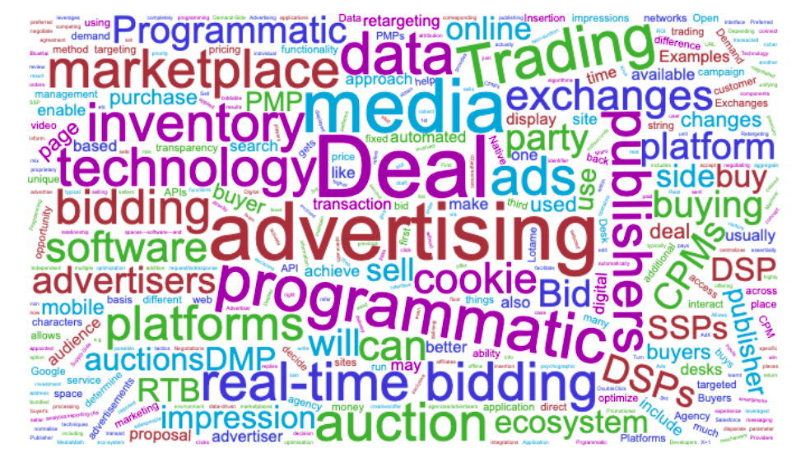
Ad tech: heavy on three letter acronyms…

Slide 5
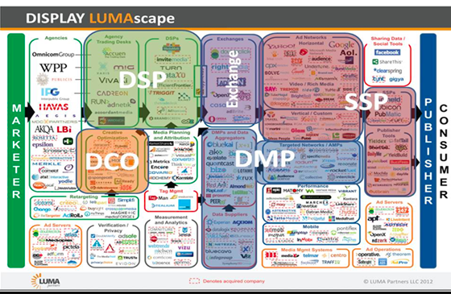
…and a myriad of suppliers

Slide 6
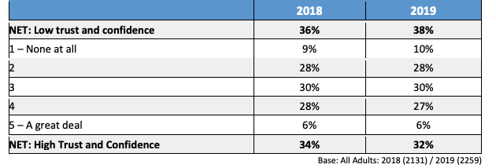
Whilst consumers show low levels of trust
Source: ICO Harris Research 2019

Slide 7
DMA/ISBA full guidance will include:
De-mystify the ad-tech jargon
De-mystify cookies – first party vs third party
Workflow explanations
Explain the IAB TCF Framework
Explain Google’s role in this eco-system
Explain CMPs (Consent Management Platforms)
Highlight relevant codes of conduct
Provide education opportunities

Slide 8
Step 2: Understand the data journey
Do you understand how personal data is processed?

Slide 9
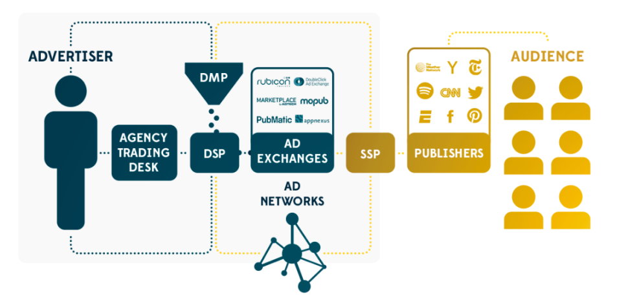
Programmatic - a complex web of technology
Source: ProTableau

Slide 10
The data journey checklist
Are you sufficiently familiar with the principle of accountability?
What digital advertising activity is taking place?
Do you understand data processing activities? What? When? Who? How?
Is the contractual basis on which data is handled sufficiently clear?
Are you confident about the warranties being offered by other companies?
How much due diligence has been conducted when appointing suppliers?
Is an audit programme in place to confirm contractual commitments?
Do you have an up to date ROPA (Record of Processing Activity)?

Slide 11
Step 3: Special category data
Are you processing explicit or inferred special category data?

Slide 12
What is special category data?
personal data revealing racial or ethnic origin;
personal data revealing political opinions;
personal data revealing religious or philosophical beliefs;
personal data revealing trade union membership;
genetic data;
biometric data (where used for identification purposes);
data concerning health;
data concerning a person’s sex life; and
data concerning a person’s sexual orientation.
Source: ICO

Slide 13
Inferred special category data…
“Special category data includes personal data revealing or concerning the above types of data. Therefore, if you have inferred or guessed details about someone which fall into one of the above categories, this data may count as special category data. It depends on how certain that inference is, and whether you are deliberately drawing that inference”
Source: ICO

Slide 14
Conditions for processing special category data
Article 9 lists the conditions for processing special category data:
(a) Explicit consent
(b) Employment, social security and social protection (if authorised by law)
(c) Vital interests
(d) Not-for-profit bodies
(e) Made public by the data subject
(f) Legal claims or judicial acts
(g) Reasons of substantial public interest (with a basis in law)
(h) Health or social care (with a basis in law)
(i) Public health (with a basis in law)
(j) Archiving, research and statistics (with a basis in law)
Source: ICO

Slide 15
And processing probably requires a DPIA
“You must do a DPIA for any type of processing that is likely to be high risk. This means that you are more likely to need to do a DPIA for processing special category data”
Source: ICO

Slide 16
Step 4: Carry out a DPIA?
Have you assessed whether the impact of data processing is proportionate?

Slide 17
When you should conduct a Data Protection Impact Assessment (DPIA)?
“Where a type of processing in particular using new technologies, and taking into account the nature, scope, context and purposes of the processing, is likely to result in a high risk to the rights and freedoms of natural persons, the controller shall, prior to the processing, carry out an assessment of the impact of the envisaged processing operations on the protection of personal data. A single assessment may address a set of similar processing operations that present similar high risks.”
The ICO has made it clear that businesses involved in Ad Tech should be conducting DPIAs
Source: ICO

Slide 18
Specific scenarios - when to conduct a DPIA
Evaluation or scoring
Automated decision-making with legal or similar significant effect
Systematic monitoring
Sensitive data or data of a highly personal nature
Data processed on a large scale
Matching or combining datasets
Data concerning vulnerable data subjects
Innovative use or applying new technological or organisational solutions
Preventing data subjects from exercising a right or using a service or contract
Source: ICO

Slide 19
Steps to conduct DPIA
Step 1: identify the need for a DPIA
Step 2: describe the processing
Step 3: consider consultation
Step 4: assess necessity and proportionality
Step 5: identify and assess risks
Step 6: identify measures to mitigate the risks
Step 7: sign off and record outcomes
Source: ICO

Slide 20
Step 5: Audit supply chain
Can you provide privacy assurance beyond supplier contracts?

Slide 21
Are your contracts robust?
Does the contract set out what personal data is used for what purpose?
Is the contracted partner a Controller, Joint Controller or Processor?
Do you have the necessary Data processing or Controller Agreements in place?
Does the contract highlight the importance of confidentiality?
Does the contract provide for audits and inspections?
Is it clear who is accountable and liable for different activities?
Is there a provision to cover third party processing of data?
What process for managing data when the contract ends?

Slide 22
Potential audit scope
Appointed a DPO?
Robust/documented policies and processes for handling personal data?
Robust and appropriate security and access arrangements?
Appropriate data and privacy training for employees?
Certification or accreditation relating to storage of data?
Processes for reporting a data breach?
Retention policies in place?
Non-EU data processing arrangements?
Managing rights of data subjects?
Scope of third party organisations processing personal data?

Slide 23
Step 6. Evaluate ROI of opportunities
Can you measure the advertising outcome?

Slide 24
Tools to measure marketing ROI and performance
Brand Studies
Econometrics/Marketing Mix Modelling
Brand Studies
Long Term
(months to years)
Controlled Experiments
Mid Term
(weeks to months)
Attribution
Near Term
(days)
Awareness Action Purchase Loyalty
Reproduced from IAB Guide to Measuring Digital Advertising in a Multi-Media Context

Slide 25
What does future hold for cookies?
First party cookies: highly prized
Third party cookies: a less rosy future blocked by browsers
Latest update on e-privacy – re-introduction of Legitimate Interest? But don’t hold your breath
Watch for innovation from players such as Google e.g.”Federated Learning of Cohorts”
Contextual advertising - back to the future!

Slide 26
Questions?

