Slide 2
Origin
An introduction – Advertiser Levy Consultation
20th April 2022

Slide 3
Compliance Statement
ISBA’s purpose is to represent its members and to protect the freedom to advertise responsibly. It is ISBA policy to avoid any anti-competitive activity either by its members or by others.
The guiding principle for ISBA meetings and activities is that whatever action or policy is discussed it is up to each member individually to take its own advice and to decide what steps it will take in any trading relationships. ISBA may facilitate discussion between members on lawful matters of common interest but ISBA will not become involved in anything it believes could be perceived to be a breach of the competition rules.
Any data supplied to ISBA by a member for benchmarking exercises will be retained on a confidential basis and will never be disclosed to other members except in any anonymised form where individual companies cannot be identified.
ISBA meetings will only be held on the basis of agendas prepared in advance, and recorded by minutes prepared shortly afterwards.
Unless competition law advice has been obtained to say it is acceptable in the circumstances, there will be no discussion at meetings (or before or after meetings) of confidential commercially-sensitive information, including especially information as to prices, advertising rates, discounts or terms of trade. The chair person will halt any discussion that strays into these areas. If anyone is in doubt as to whether a given topic should be discussed, they should draw the attention of the meeting to the issue and the Chair will determine whether that discussion should be postponed to a future meeting, with competition law advice sought in the meantime.

Slide 4
Today:
Brief introduction to Origin
Overview of the Levy
Q&A

Slide 5



Phil Smith
Director General
ISBA
Joe Lewis
Measurement Lead
Origin
Martin Lawson
Product Lead
Origin

Slide 6
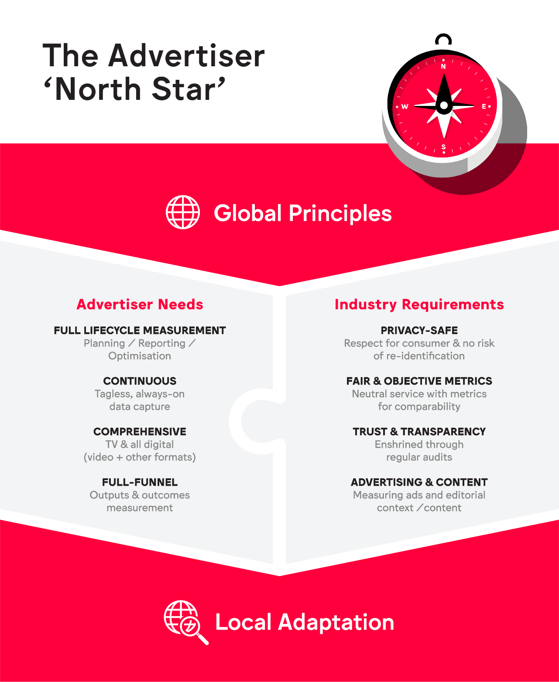
The aim: deliver the WFA ‘North Star’ in the UK
  Advertisers have set an ambitious
  set of needs
  They are complemented by advertiser-supported industry requirements
  We have agreed priorities for ‘day one’: video and display, reach and frequency
  Planning for an expanded remit is already underway

Slide 7











We are continually expanding our support on both buy and sell sides…
+ watch this space…
+ watch this space…

Slide 8
Our focus has changed from ‘proving & planning’ to ‘building & testing’
Phase 1
A good idea?
Phase 2a
Could it work?
Phase 2b
Does it work?
Phase 3
Build
Phase 4
Trials & Venture
Phase 5
Launch
2022
2023
2024
We are here

Slide 9
In the early stages of the live service, we envisage 4 Origin products
Data Granularity
Core Reporting is designed to fulfil the primary advertiser use case:
Reporting total, unique & incremental reach & frequency
Informing the movement of budget within a campaign
Duration/viewability data reported against user-defined standards
Data provided at channel (e.g. social) and publisher (e.g. Facebook) levels
Cut by the most important audiences (age, gender, social grade, presence of kids)
Core
Premium
Reporting
Campaign
Tactical
Planning

Slide 10
Advertiser Levy – the industry-wide consultation is in play
We want to make Origin as affordable and accessible as possible
Our commercial model has an advertiser levy at its centre. The premise:
The levy would be charged on all media activity measured by Origin
Opt-out, capped at a reasonable threshold
Levy would pay for the ‘Core Reporting’ service (other services to be charged separately)
ISBA is leading an industry-wide consultation, which closes on May 20th
The process seeks to confirm that advertisers support the principle of part-funding Origin via a levy

Slide 11
Q&A

