Slide 1
ISBA Representation in Advertising Tracker
February 2023

Slide 2
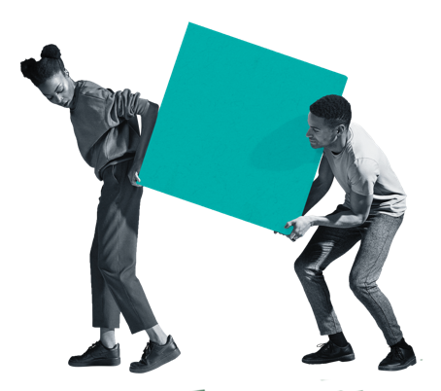
Views that TV ads reflect modern British society have slightly declined this wave
TV adverts reflect modern British society (% agree)
Significantly higher/lower than February 2022 at 95% confidence
Base: Nat rep (1,000)

Slide 3
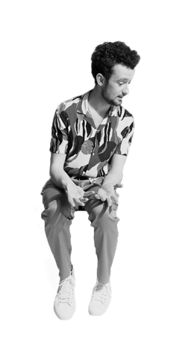
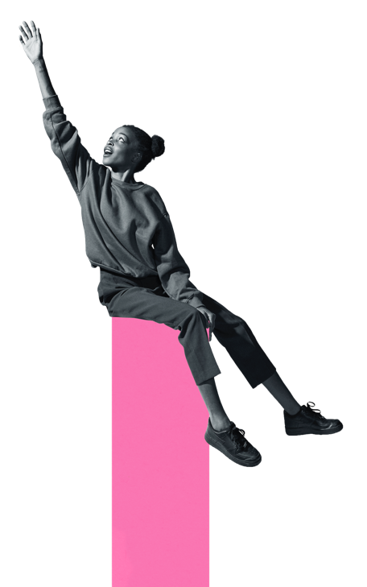
Say it is important for different groups in society to be well represented in TV adverts (% agree)
67%
69%
February 2022
August 2022
65%
February 2023
Base: Nat rep (1,000)

Slide 4
The belief that ads represent all groups of society have stayed stable* (% agree)
Significantly higher/lower than February 2022 at 95% confidence
*e.g. ethnic minorities, LGBTQ+, people with disabilities, etc.
Base: Nat rep (1,000)

Slide 5
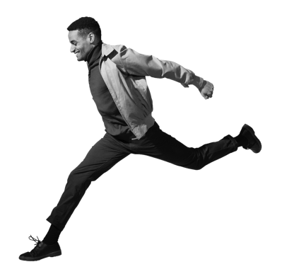
Across industries, viewers see an increasing amount of effort to be inclusive in their advertising (%)
Making more effort
Making less effort
-1%*
-3%*
+0%*
-1%*
+0%*
-1%*
+1%*
+4%*
Significantly higher/lower than February 2022 at 95% confidence
A lot/some effort
Not much/no effort
*difference vs. previous wave
Base: Nat rep (1,000)

Slide 6
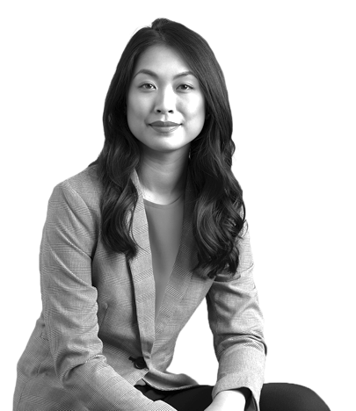
UK adults still tend to overestimate ad representation, compared to diverse groups, though the gaps are closing
Say these groups are well represented in TV adverts (% agree)
Total
Among that group
Significantly higher/lower than February 2022 at 95% confidence
Base: Nat rep (1,000), Females (510), Black (54), LGBTQ+ boost (218), South Asian (82), East Asian (12), Other minority ethnic (69), Lower social grade (276), Disabilities (358)

Slide 7
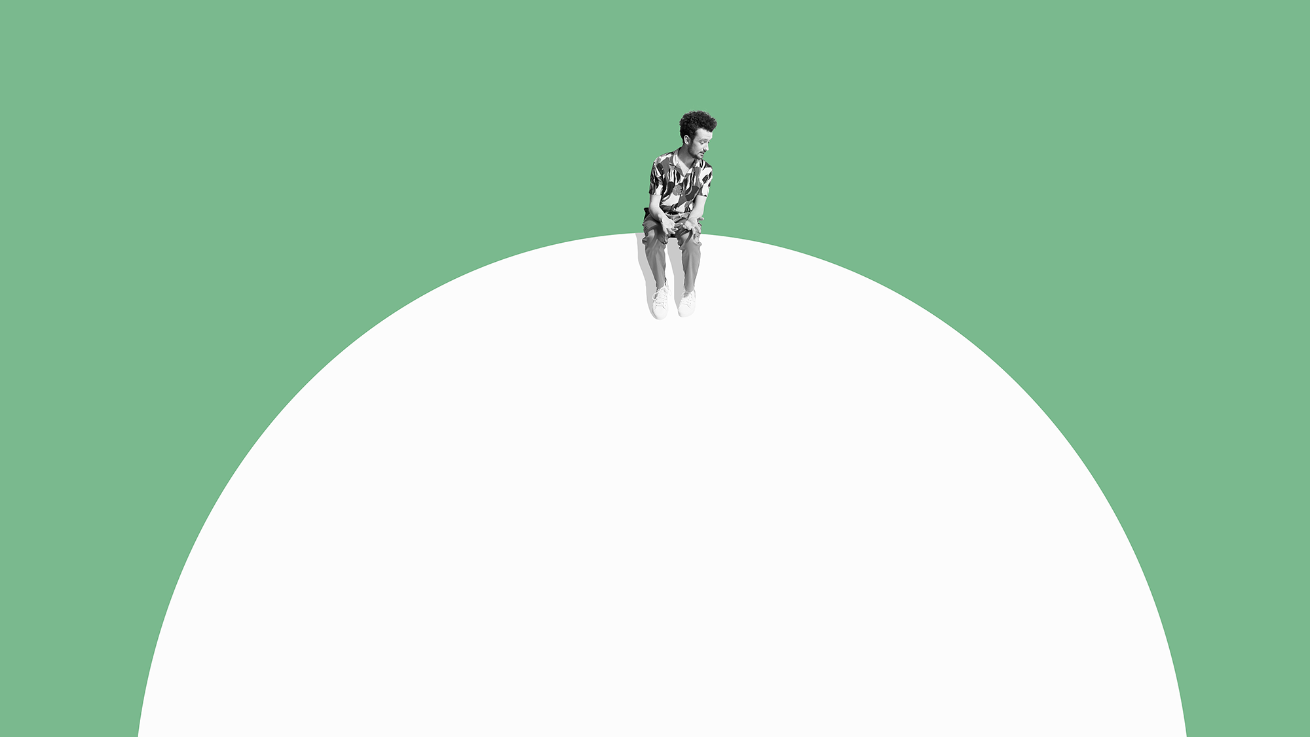
Source: Opinium Survey, 1st-14th February 2023.
A national representative sample of 1,000 TV watchers sourced from Opinium’s proprietary panel, with boosts of minority ethnic and LGBTQ+ respondents (additional n=150 each)

