Slide 1
Representation in Advertising Tracker
ISBA
March 2024

Slide 2
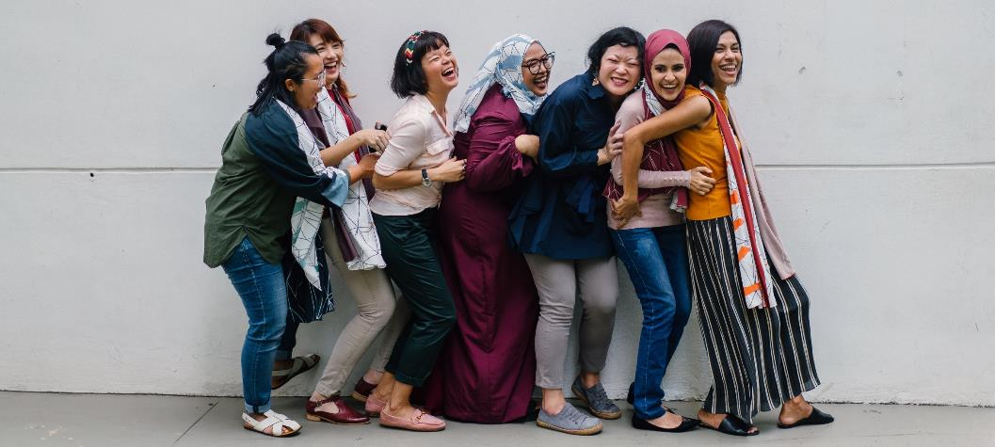
Background and objectives
Background
ISBA is committed to fighting discrimination and working towards an environment that is respectful of diversity and champions inclusivity.
ISBA recognise that the advertising industry has often been guilty of not truly representing the UK in all of its diversity in terms of race, class and sexuality in the past.
This study monitors attitudes towards the representation of different groups within the industry. Identifying ways to improve across individual sectors and the advertising industry at large.

Slide 3



Research methodology
Methodology
OUR METHODOLOGY
RATIONALE
A nationally representative sample of 1,000 TV watchers sourced from Opinium’s propriety panel, with boosts of Minority ethnic and LGBTQ+ respondents (n=150 each)
A nationally representative sample allows for a bird’s eye view of the UK, with boosts to ensure key groups’ voices are heard and their views represented
Nationally representative weighting on gender, age and region
Ensuring the sample is representative of the UK
10-minute online survey
Covering demographics, TV viewership, attitudes towards representation in TV advertising in general and in different industries

Slide 4
Questionnaire coverage
Questionnaire
DEMOGRAPHICS
2 minutes
Ensures we are speaking to a relevant and representative group
TV VIEWERSHIP & ATTENTION TO ADVERTISING
1 minute
Allows us to profile by frequency of viewership and attention to advertising
ATTITUDES TOWARDS REPRESENTATION IN TV ADVERTISING
Understanding attitudes towards diversity & inclusion in TV advertising in general, with regards to particular groups, and across industries
4 minutes

Slide 5
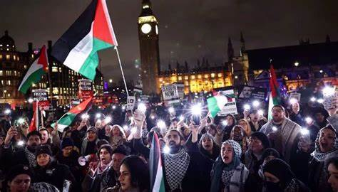
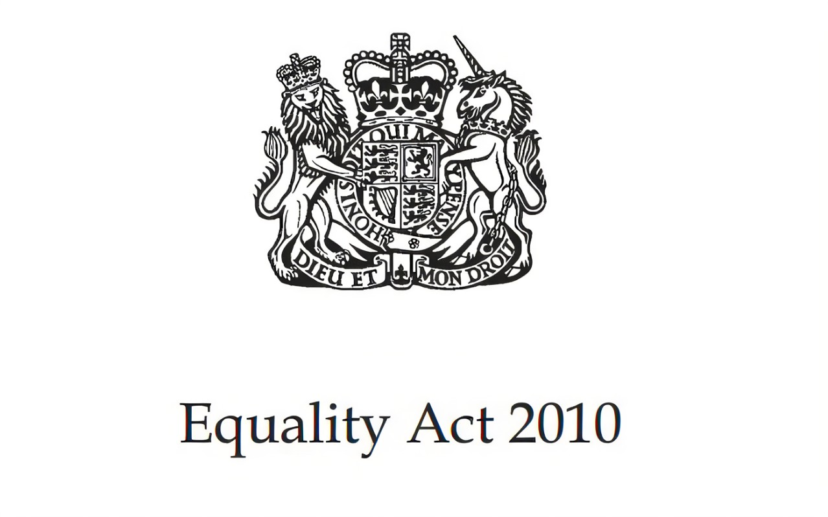
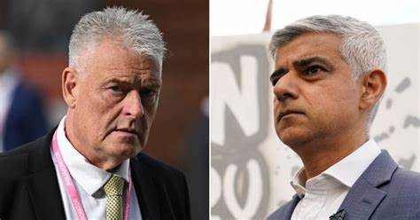
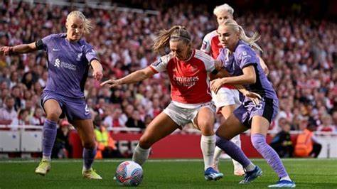
There were a number of relevant major developments between waves 8 and 9 of the survey
Timeline
September | October | November | December | January | February | March
Wave 7 fieldwork
1st August – 14th August
Wave 8 fieldwork
28th February – 12th March 2024
October
The conflict between Israel and Gaza has resulted in heightened tensions in several minority groups through the course of the last six months
January
Changes are made to the UK’s Equality Act, removing former EU protections, but also simplifying and widening the scope of the law
February
MP Lee Anderson is suspended from the Conservative Party following ‘Islamophobic’ comments made about London Mayor Sadiq Khan
March
The Women’s Super League breaks its all-time season attendance record with six weeks still to go: 717,219 people attended a game in the 2023/24 season to date

Slide 6



Perceived diversity in advertising has decreased since August, though not significantly and remains higher than a year ago
Results
“TV adverts reflect modern British society”
% agree
62%
say it’s important for different groups in society to be well represented
45%
42%
51%
43%
45%
42%
38%
43%
41%
Opinium
March ‘20
Opinium
August ‘20
Opinium
February ‘21
Opinium
August ‘21
Opinium
February ‘22
Opinium
August ‘22
Opinium
February ‘23
Opinium
August ‘23
Opinium
March ‘24
66%
August ‘23
“TV adverts do a good job of representing all groups within British society (e.g. ethnic minorities, LGBTQ+, people with disabilities, etc)”
% agree
42%
36%
45%
41%
47%
45%
43%
47%
45%
25%
42%
Opinium
March ‘20
Opinium
August ‘20
Opinium
February ‘21
Opinium
August ‘21
Opinium
February ‘22
Opinium
August ‘22
Opinium
February ‘23
Opinium
August ‘23
Opinium
March ‘24
Significantly higher/lower than August '23 at 95% confidence
Base: Nat rep (1,000)
Notes:
Sig test

Slide 7
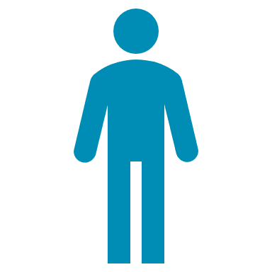


The oldest generations are far less likely to feel representation is important or agree TV adverts are good at doing this
Results
62%
“I feel that adverts reflect what modern life is like, and they often feel relatable. I feel that they keep up to date with moving trends and adapt well to show changes in society”
Male, 44, Yorkshire and Humberside,
White, Straight
say it’s important for different groups in society to be well represented
66%
August ‘23
71%
68%
70%
66%
55%
47%
16-24
25-34
35-44
45-54
55-64
65+
41%
say TV adverts reflect modern British society
43%
August ‘23
“More biased towards ethnic minorities and do not reflect true proportionate make up of British population”
Female, 68, Wales, Straight
48%
52%
39%
42%
41%
28%
16-24
25-34
35-44
45-54
55-64
65+
45%
say TV adverts do a good job of representing all groups within British society
47%
August ‘23
56%
55%
51%
42%
48%
29%
16-24
25-34
35-44
45-54
55-64
65+
Significantly higher/lower than August ‘23 at 95% confidence
Base: Nat rep (1,000), 16-24 (134), 25-34 (168), 35-44 (156), 45-54 (172), 55-64 (146), 65+ (223)
Notes:
Sig test including ages

Slide 8
Among ethnic minorities, there has been a decrease in the number who agree TV adverts reflect modern British society since last wave
Results
UK total
Minority ethnic
“TV adverts now are a lot more diverse in terms of the people they show than 10 years ago.”
Female, 51, London, Other Mixed background, Straight
Say it’s important for different groups in society to be well represented
62%
81%
66%
August ‘23
81%
August ‘23
41%
60%
Say TV adverts reflect modern British society
43%
August ‘23
67%
August ‘23
“TV adverts remain largely stereotypical and misrepresentative of black people in the UK”
Male, 46, London Other black background, Straight
Say TV adverts do a good job of representing all groups within British society
45%
55%
47%
August ‘23
57%
August ‘23
Significantly higher/lower than August '23 at 95% confidence
Base: Nat rep (1,000), Minority ethnic boost (268)

Slide 9
Positive attitudes among the LGBTQ+ community have decreased this wave especially those agreeing TV adverts are good at representation
Results
UK total
LGBTQ+
“We're seeing more same sex couples such as in the Pandora ad, we see blind people in the Bisto ad, black people in lots of ads too”
Female, 49, South West, White, Bisexual
Say it’s important for different groups in society to be well represented
62%
78%
66%
August ‘23
82%
August ‘23
41%
52%
Say TV adverts reflect modern British society
43%
August ‘23
54%
August ‘23
“Do not reflect properly the mix of society, too much emphasis on black race people instead of a mix of Asian, and other ethnicities”
Male, 39, North West, White, Gay
Say TV adverts do a good job of representing all groups within British society
45%
49%
47%
August ‘23
58%
August ‘23
Significantly higher/lower than August '23 at 95% confidence
Base: Nat rep (1,000), LGBTQ+ boost (209)

Slide 10
Results
Representation perception gaps are narrowing for some minority groups, however there are some drops, especially among older people
Total
Among that group
Say these groups are well represented in TV adverts – compared to among that group
Significantly higher/lower than August '23 at 95% confidence
Base: Nat rep (1,000), Females (509), Black (82), LGBTQ+ boost (209), South Asian (97), East Asian (11), Other minority ethnic (78), Lower social grade (306), Disabilities (346), 65+ (223)

Slide 11
In general, people who agree society is well represented also agree these groups are well represented – but particularly those who say so about over-65s, other minority ethnic groups and those from a lower social grade
Total
Say TV adverts reflect modern British cociety
+18%
Say these groups are well represented in TV adverts – compared to those who agree TV adverts reflect modern British Society
+19%
+22%
+22%
+19%
+19%
+18%
+21%
+16%
Base: Nat rep (1,000), Agree TV adverts reflect modern British society (405)

Slide 12
Results
While perceived representation is on a downward trend for females, it has increased among the Black and LGBTQ+ communities over the last 3 years
Among that group
Say these groups are well represented in TV adverts
*
* Low base size
Base: Nat rep (1,000), Females (509), Black (82), LGBTQ+ boost (209), South Asian (97), East Asian (11), Other minority ethnic (78), Lower social grade (306), Disabilities (346), 65+ (223)

Slide 13
Three in five UK adults think TV adverts are currently accessible, though this is lower among those with disabilities, women and older people
Results
Percentages who say TV adverts are accessible / not accessible
Accessible
Not Accessible
Base: Nat rep (1,000), Females (509), Minority ethnic boost (268), LGBTQ+ boost (209), Lower social grade (306), Disabilities (346), 65+ (223)

Slide 14








There have been significant declines among several industries in the effort seen to represent minority groups
Results
Not much / no effort
A lot / some effort
Making more effort
Making less effort
Food & drink
Clothing & accessories
Cosmetics & personal care
Household goods
Holidays & travel
Electrical goods
Finance
Cars
Significantly higher/lower than August '23 at 95% confidence
Base: Nat rep (1,000)

Slide 15
Results
Perceived effort declined across all categories in this wave
A lot / some effort
Food & drink
Clothing & accessories
Cosmetics & personal care
Holidays & travel
Household goods
Electrical goods
Cars
Finance
Base: Nat rep (1,000)

Slide 16
Results
Across all industries, perceived effort has dropped to lower levels than we have seen since August 2021
A lot / some effort
All industries
Base: Nat rep (1,000)

Slide 17
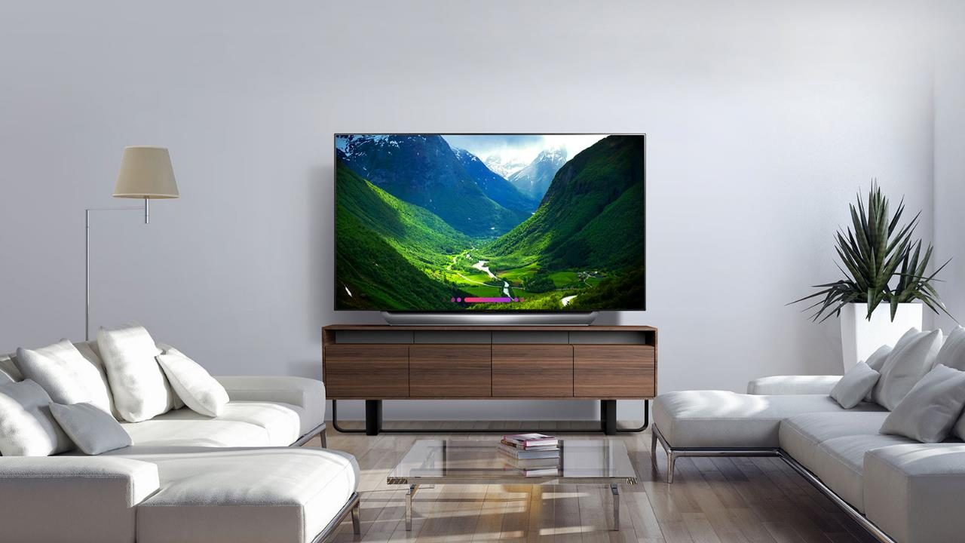

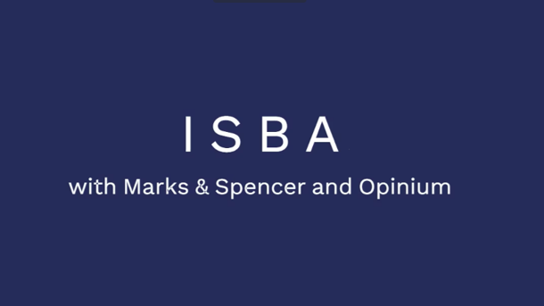
Results
March 2024: Recent TV ads that stood out to viewers as representing diversity & inclusion
March 2024
17

Slide 18
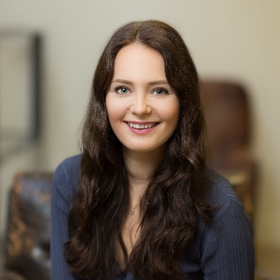

Ande Gilmartin
Matthew Howlett
Associate Director
andegilmartin@opinium.com
Senior Research Executive
matthewhowlett@opinium.com

