Slide 1
Retail Media 2025 Priorities setting
Wednesday 12th February 2025

Slide 2
Agenda
ISBA Retail Media Workstreams and 2025 Objectives Dan Larden – Head of Media
Introducing the Retail Media Playbook
Fiona Davis – Global VP CvE
Paving the way for Retail Media to succeed in Europe
Marie-Clare Puffett - Industry Director IAB Europe
IAB UK Retail Media Workstreams
James Chandler – CMO IAB UK
Q&A

Slide 3
Retail Media Timeline
Launch Retail Media Brand Playbook
Media Leaders Steering Group raised as a priority
Retail Media Standardisation Launched
Mediasense & ISBA UK Retail Media Landscape Study
Kick Off
UK Retail Media Landscape Study released
4 Major UK RMNs Reviewed
Jun 2023
Feb 2025
Jan 2023
Mar 2024
Jan 2023
Oct 2022
Creation of cross industry Retail Media Steering Group
Jan 2023
Draft standards released for peer review
Nov 2023
IAB Europe incorporates ISBA standard within their framework
Sep 2024
May 2025
Support the IAB Europe RM Certification program
RMN Self Assessment against the framework

Slide 4
ISBA & Mediasense Retail Media Study

Slide 5





















ISBA & Mediasense UK Retail Media landscape study
Funding Partners
Demand side Scope:
Operating models
Strategy, planning and source of budgets
Execution, Performance Metrics and Reporting
Tools and Platforms used
Use of data
Challenges and opportunities
Ecosystem Participants
Circa £220m spend UK Media: NMR
Supply side Scope:
Revenue streams and service models
Use of internal / external tech / tools
Data Validation and Governance
Inventory Management
Growth and Performance
Challenges and opportunities

Slide 6
Retail Media Standards

Slide 7
Self Assesssment - Off Retail
 | RMN1 | RMN2 | RMN3 | RMN4 | RMN5 | RMN6
Consistent view of data between campaigns | Yes | N/A | Yes | On Roadmap | Yes | Yes
Extractable pre-templated format across all campaigns | Yes | N/A | Yes | On Roadmap | Yes | Yes
PCR within 6 weeks after the attribution window closes | Yes | N/A | Yes | Yes | Yes | Yes
All data points are available in open API | Yes | N/A | Yes | On Roadmap | Yes | On Roadmap
Provide a glossary of metrics | Yes | N/A | Yes | Yes | Yes | Yes
in-flight data and in a templated extractable format | Yes | N/A | Yes | On Roadmap | Yes | Yes
Data available in-flight through an API solutions | Yes | N/A | On Roadmap | No | Yes | On Roadmap
user frequency and unique v total impressions | Yes | N/A | On Roadmap | Yes | Yes | Yes
Open and transparent New to brand definitions* | Yes | N/A | Yes | No | Yes | Yes
Flexibility of attribution windows (7, 14, 30 days) | Yes | N/A | Yes | No | On Roadmap | On Roadmap
Media sales data available in-flight | Yes | N/A | Yes | No | Yes | Yes
Media sales data in-flight via an API solutions | Yes | N/A | On Roadmap | No | Yes | Yes
*across media being used explicitly calling out rationale behind methodologies and considerations against omnichannel touchpoints, and shopper category behaviour (if they have been taken)
Notes:
- We asked our group to prioritise a list of standards from our Retail Media Framework that are of the highest importance. The consensus was on concentrating on getting standards that allow for speed and accuracy of data ingestion, that would help provide more clarification as to the benefit of the investment over and above other channels

Slide 8
Self Assesssment - On Retail
 | RMN1 | RMN2 | RMN3 | RMN4 | RMN5 | RMN6
Consistent view of data between campaigns | Yes | In Progress | Yes | On Roadmap | Yes | Yes
Extractable pre-templated format across all campaigns | Yes | In Progress | Yes | On Roadmap | Yes | Yes
PCR within 6 weeks after the attribution window closes | Yes | Yes | Yes | Yes | Yes | Yes
All data points are available in open API | Yes | In Progress | Yes | On Roadmap | Yes | On Roadmap
Provide a glossary of metrics | Yes | Yes | Yes | Yes | Yes | Yes
in-flight data and in a templated extractable format | Yes | In Progress | Yes | Yes | Yes | Yes
Data available in-flight through an API solutions | Yes | No | On Roadmap | No | Yes | On Roadmap
user frequency and unique v total impressions | Yes | Yes | On Roadmap | Yes | Yes | Yes
Open and transparent New to brand definitions* | Yes | Yes | On Roadmap | No | In Progress | Yes
Flexibility of attribution windows (7, 14, 30 days) | Yes | Yes | On Roadmap | No | On Roadmap | On Roadmap
Media sales data available in-flight | Yes | Yes | Yes | Yes | Yes | Yes
Media sales data in-flight via an API solutions | Yes | No | On Roadmap | No | Yes | On Roadmap
*across media being used explicitly calling out rationale behind methodologies and considerations against omnichannel touchpoints, and shopper category behaviour (if they have been taken)

Slide 9
Self assessment – In Store
 | RMN1 | RMN2 | RMN3 | RMN4 | RMN5 | RMN6
Consistent view of data between campaigns | N/A | N/A | Yes | On Roadmap | Yes | Yes
Extractable pre-templated format across all campaigns | N/A | N/A | Yes | On Roadmap | Yes | Yes
PCR within 6 weeks after the attribution window closes | N/A | N/A | Yes | Yes | Yes | Yes
All data points are available in open API | N/A | N/A | Yes | On Roadmap | Yes | On Roadmap
Provide a glossary of metrics | N/A | N/A | Yes | On Roadmap | Yes | Yes
in-flight data and in a templated extractable format | N/A | N/A | Yes | On Roadmap | No | Yes
Data available in-flight through an API solutions | N/A | N/A | No | No | No | On Roadmap
user frequency and unique v total impressions | N/A | N/A | No | No | No | Yes
Open and transparent New to brand definitions* | N/A | N/A | On Roadmap | No | Yes | Yes
Flexibility of attribution windows (7, 14, 30 days) | N/A | N/A | No | No | On Roadmap | No
Media sales data available in-flight | N/A | N/A | Yes | No | No | No
Media sales data in-flight via an API solutions | N/A | N/A | No | No | No | No
*across media being used explicitly calling out rationale behind methodologies and considerations against omnichannel touchpoints, and shopper category behaviour (if they have been taken)
Notes:
Key points that this document raised:
The devil was in the detail - often where a RMN had highlighted something as available there were caveats added in the notes, for example 'dependent on spend' or that metrics were available but had to be requested and pulled manually
The group believed that reported capabilities does indeed differ from actual experiences and delays in available data are still very common
A member suggested that we could compare and contrast this summary with the MARS agency report which had similar detail for the UK - we will look into this

Slide 10
2025 Priorities for our Retail Media Steering Group
Unified Trade Bodies Representation
Retailer and Brand Collaboration
Consistency in Retail Media Networks
Challenges with Media and Trade Disconnect
Role of Agencies
Measurement and Incrementality
Connecting Media Touchpoints
Creative Challenges
Internal Operating Models
Notes:
Call to unify all three trade bodies for consistency and collaboration, addressing current sensitivities and overlaps causing confusion and inefficiencies.
Retailer and Brand Collaboration:
Retailers should adopt a media-focused approach to unlock budgets and improve long-term performance. Discussion on wider rate card options.
Consistency in Retail Media Networks:
Lack of consistency in retail media setups complicates campaign processes for brands. Complexity and fragmentation in retail media, including different budget pots and principles, hinder effective planning and execution.
Challenges with Media and Trade Disconnect:
Disconnect between media and trade teams within companies creates issues in budget allocation and performance expectations.
Role of Agencies:
Agencies contribute to complexity with capability gaps and lack of collaboration within their teams.
Measurement and Incrementality:
Need for better measurement frameworks, particularly around incrementality, as current systems are inconsistent in showing effectiveness.
Connecting Media Touchpoints:
Importance of integrating various media touchpoints (on-site, in-store, and off-site) to create a cohesive strategy, justify costs, and show value.
Creative Challenges:
Challenges with creative consistency across different retail media networks, including last-minute changes in spec requirements and lack of standardization. Involvement of creative agencies varies, with some solutions using specialist agencies or handling it in-house.
Internal operating Models
Internal pressure due to JVPS, sometimes run by trading account managers rather than marketing, leading to locked spending.

Slide 11
How to succeed with Retail Media in 2025
Feb 2025

Slide 12
Contents
Reviewing the definition of retail media
Intro to CvE’s retail media playbook – key areas of focus
Deep dive into 2 focus areas:
  How the ways of working, client/agency operating models, and internal capabilities are changing for both brands and retailers
  Leveraging your JBP process to drive maximum value from the ecosystem and support brand marketing goals more effectively
Q&A
12

Slide 13


Reframing retail media as retail marketing
Chat CPT says the following:
Retail media refers to advertising and marketing strategies that take place within retail environments, both online and in physical stores. It typically involves brands promoting their products directly on a retailer's platforms (like websites, mobile apps, and even in-store displays) to reach shoppers at the point of purchase or decision-making.
At CvE we have reframed it as retail marketing:
It is the convergence of Shopper and Trade Marketing with Retail Digital Media, using integrated data and inventory from across the ecosystem (retailer, brand, publisher) to bring omnichannel marketing for brand buyers across all retail activation points. The end goal is an integrated retail marketing plan with data insights and measurement to prove revenue impact and marketing effectiveness.
13

Slide 14








Retail Marketing – An Omnichannel Connected Proposition is the goal
On-site, offsite, in-app, in-store, and customer insights
Retailers look to provide an integrated package of touchpoints available to a brand with unified measurement showing incremental revenue generation and customer insights
Brands are looking for an integrated retail marketing experience to their customers across all retail channels that can prove revenue impact, and provide overall impact analysis across all channels
Publishers are looking to provide high quality brand safe inventory and customer data packaged and integrated in a way that fits a brand’s overall marketing goals and integrated commerce opportunities
DOOH

Slide 15
The many moving parts of a retail marketing ecosystem
Retailers
Brands
Publishers
In-store/POS
Onsite/Offsite inventory mgmt. & monetisation
Data Partnerships (Publishers, Retail, Loyalty, Content)
Loyalty Programs
Data Privacy Management/Control
Go-To-Market Strategy
Sales enablement
Media trafficking/trading
Data insights/platforms
Measurement for all stakeholders
Trade Budgets vs Media Budgets (brand, e-comm, performance)
JBP Strategy and Execution
Brand, content and creative strategy & execution
Omnichannel measurement & full funnel MMM
Customer data usage and integrated 2PD strategies
Data insights across all customer touchpoints and engagement
Standardization of Offering vs Innovation & Differentiation
Change in Relationship with Brands as both Buyer & Seller
Onsite/Offsite inventory mgmt & monetisation
Integrated content & commerce offerings
Data Partnerships ( Retailers, Brands, E-Comm providers)
Customer data monetisation
Data Privacy Management/Control
GTM Strategy & Sales enablement
Media trafficking/trading
Data insights
Direct sold & integrated partnerships
15
Notes:
Talent shortages and headcount constraints
Margins tight across all stakeholders
Pricing transparency

Slide 16
The many moving parts of a retail marketing ecosystem
Retailers
Brands
Publishers
In-store/POS
Onsite/Offsite inventory mgmt. & monetisation
Data Partnerships (Publishers, Retail, Loyalty, Content)
Loyalty Programs
Data Privacy Management/Control
GTM Strategy & Sales enablement
Media trafficking/trading
Data insights/platforms
Measurement for all stakeholders
JBP Strategy and Execution
Trade Budgets vs Media Budgets (brand, e-comm, performance)
JBP Strategy and Execution
Brand, content and creative strategy & execution
Omnichannel measurement & full funnel MMM
Customer data usage and integrated 2PD strategies
Data insights across all customer touchpoints and engagement
Standardization of Offering vs Innovation & Differentiation
Onsite/Offsite inventory mgmt & monetisation
Integrated content & commerce offerings
Data Partnerships ( Retailers, Brands, E-Comm providers)
Customer data monetisation
Data Privacy Management/Control
GTM Strategy & Sales enablement
Media trafficking/trading
Data insights
Direct sold & integrated partnerships
16

Slide 17










Where CPG’s are laser focused today
Cross-Retailer Buying and Measurement
Cross channel planning and measurement
Unified Data Management
Audience Insights
JBP integration and standardisation
Removing buying friction across RMNs
Consolidation of RMN partners
Standardised measurement of incremental sales cross-retailer
Creating CPG owned centralised data repository with clean room integrations
Determining right balance of 1PD vs 2PD/3PD to drive effectiveness and CX.
Leveraging Retail Media insights to inform more personalised and integrated customer journey activation
Integrated JBP & Cross Channel Media planning to drive the right investments
A more common framework for JBP process cross retailer to drive best practice
Robust CPG owned MMM to drive allocation of budgets strategically across the full funnel
Comparing RMN performance as part of that mix
17

Slide 18
CvE Retail Media Playbook Highlights

Slide 19


Intro to CvE’s Retail Marketing Playbook – Key Focus Areas
Convergence of Shopper Marketing, E-Comm and Retail Media
Evolution of the JBP Process for Brands and Retailers
Evolving operating models – right housing for brands and retailers
Measuring Impact across the full funnel
Data Partnerships, Marketplaces and Monetisation
Inventory mgmt. and packaging with the right data
The impact of Social Commerce on Brand Marketing
The impact of AI on Retail Marketing
19
Notes:
Power dynamics between retailers and brands have changed
JBP process now needs to pull all elements together in one holistic process beyond trade marketing for a Brand to be able to understand the value of an integrated programme, and for a retailer to understand what the Brand marketer is trying to achieve and provide the right marketing mix and activation to meet those needs
Both brands and retailers are taking a much larger hand in their tech and data approaches to leverage all the data at their disposal in a privacy centric way (CDPs and Data Clean romos at the Forefront)
Measurement is evolving to be full funnel with brands building their own sophisticated MMM approaches to show incremental revenue
Data Partnerships and non-endemic data monetisation are key trends in the US as revenue streams for retailers start to hit the top of the maturity curve for onsite and offsite sell through
Inventory mgmt is not just about upfront deals to get Access to premium inventory cheaply – it’s about overlaying the right audience segment against exactly the right inventory for máximum impact and efficiency
Social commerce is driving user behaviours in APAC and a different level of integration across the ecosystem as a result. That means a lot more influencer content integration for both retailers and publishers in the ecosystem, you can see Asos as a great example of a retailer pushing in this direction in the UK
AI impact on retail comes from several angles: process automation to speed up operational tasks, expansión of creative capabilities at scale, scaled individual customer journeys using agentic AI and updating your infrastructure to support AI agents

Slide 20
Deep Dive into Right-Housing for Retailers and Brands
Considerations
Right-housing the Operating Model
Financial Modelling
Media (planning, buying, selling)
Creative
Tech
Data
Measurement
Reporting
Sales
JBP Process
Organizational attitude to risk: this could mean revenue risk, reputational risk, aversion to taking headcount onto the P&L
Operational maturity: you can only in-source certain elements of your operating model when you have both the money and the resource to do it. Having a healthy revenue forecast helps justify the outlay if there is a clear path to more revenue
Right partners are key: Sometimes you need to bring in specialists to drive innovation forward (e.g. measurement or AI)
Build in flexibility: owning some key elements from your data and tech stack allows you to still outsource to strategic partners but maintain oversight into what is happening
20
Notes:
Who does the above and in what order
to develop an integrated operating model for e-comm/ merchandising/ retail/ media as a joined-up revenue engine?

Slide 21


The 4 'macro' stages of a CvE Retail Media Client’s journey & their evolving operating model maturity
In-store
Onsite
Offsite
Data Monetisation
Loyalty
Print/Cardboard
Sponsorship
Search
Onsite programmatic
Managed Service
Self-serve
Digital Screens
Data Partnerships
SSP/DSP Data
Sales Without Inventory
Customer Data Platform at the heart of every stage
21

Slide 22
One CvE client’s journey (retailer) moving through maturity stages
STAGE 1 | STAGE 2 | STAGE 3
1. Own your tech contracts
2. Own tech and data stack
3. Run audience planning in-house
HYBRID = RETAILER + PARTNER
STRATEGY/GTM
HYBRID = RETAILER+ PARTNER
STRATEGY/GTM
HYBRID = RETAILER+ PARTNER
STRATEGY/GTM
CREATIVE
CREATIVE
CREATIVE
1/2/3P DATA
1/2/3P DATA
1/2/3P DATA
MEASUREMENT
MEASUREMENT
MEASUREMENT
TECHNOLOGY
TECHNOLOGY
TECHNOLOGY
ANALYTICS
ANALYTICS
ANALYTICS
RETAIL MEDIA AGENCY
AUDIENCE PLANNING
RETAIL MEDIA AGENCY
AUDIENCE PLANNING
RETAIL MEDIA AGENCY
AUDIENCE PLANNING
MEDIA PLANNING
MEDIA PLANNING
MEDIA PLANNING
ONSITE/IN APP ACTIVATION
ONSITE/IN APP ACTIVATION
ONSITE/IN APP ACTIVATION
OFFSITE
OFFSITE
OFFSITE
INSTORE
INSTORE
INSTORE
DATA SALES
DATA SALES
DATA SALES
RETAILER
EMAIL & SMS
RETAILER
EMAIL & SMS
RETAILER
EMAIL & SMS
22

Slide 23
Evolving from in house audience planning to On Site Sophistication..
STAGE 4 | STAGE 5 | STAGE 6
4. Managed Service Onsite/In App
5. Managed Service Offsite/In App
6. Self Service Onsite
HYBRID = RETAILER + PARTNER
STRATEGY/GTM
HYBRID = RETAILER + PARTNER
STRATEGY/GTM
HYBRID = RETAILER + PARTNER
STRATEGY/GTM
CREATIVE
CREATIVE
CREATIVE
1/2/3P DATA
1/2/3P DATA
1/2/3P DATA
MEASUREMENT
MEASUREMENT
MEASUREMENT
TECHNOLOGY
TECHNOLOGY
TECHNOLOGY
ANALYTICS
ANALYTICS
ANALYTICS
RETAIL MEDIA AGENCY
AUDIENCE PLANNING
RETAIL MEDIA AGENCY
AUDIENCE PLANNING
RETAIL MEDIA AGENCY
AUDIENCE PLANNING
MEDIA PLANNING
MEDIA PLANNING
MEDIA PLANNING
ONSITE/IN APP ACTIVATION
ONSITE/IN APP ACTIVATION
ONSITE/IN APP ACTIVATION
OFFSITE
OFFSITE
OFFSITE
INSTORE
INSTORE
INSTORE
DATA SALES
DATA SALES
DATA SALES
RETAILER
EMAIL & SMS
RETAILER
EMAIL & SMS
RETAILER
EMAIL & SMS
23

Slide 24
..before evolving to in-housing Offsite and Data Partnerships
STAGE 7 | STAGE 8
7. Self-Service Offsite
8. Data Sales & Partnerships
HYBRID = RETAILER + PARTNER
STRATEGY/GTM
HYBRID = RETAILER + PARTNER
STRATEGY/GTM
CREATIVE
CREATIVE
1/2/3P DATA
1/2/3P DATA
MEASUREMENT
MEASUREMENT
TECHNOLOGY
TECHNOLOGY
ANALYTICS
ANALYTICS
RETAIL MEDIA AGENCY
AUDIENCE PLANNING
RETAIL MEDIA AGENCY
AUDIENCE PLANNING
MEDIA PLANNING
MEDIA PLANNING
ONSITE/IN APP ACTIVATION
ONSITE/IN APP ACTIVATION
OFFSITE
OFFSITE
INSTORE
INSTORE
DATA SALES
DATA SALES
RETAILER
EMAIL & SMS
RETAILER
EMAIL & SMS
24

Slide 25
Deep dive into JBP process

Slide 26
Deep Dive on JBP: What are key the components?
Category Data / Planning: Consumer, Market, Financial
Shared Objectives
National / Regional Sales Strategy
In-store & Online Merchandising; POGS
Consumer Research, Market Share, Product Trends
Retailer
Joint Business Plan
Brand
Marketing / Advertising Support
Promotional Planning, Marketing / Brand / Retail Media Investment
Media Strategy / Planning
Shared Outcomes
Supply Chain, Delivery, Logistics
26
Notes:
Both retailers and brands have had to change their internal structures and process to be more cross functionally aware. The more advanced brands and retailers are already leveraging all the data insights and measurement across all tactics to negotiate terms more holistically so both sides need to have a better understanding of the impact of performance and brand media across the portfolio including the multiplier effect it has on instore marketing when done right

Slide 27







How to get the most out of a JBP process for brands & retailers
Resetting the Brand & Retailer Relationship status
Tackling measurement as an ecosystem issue
Budget alignment & getting the right people in the room
Patience - everyone is evolving their model at the same time
Monitor, Measure, Optimise and Renew
The landscape has changed – brands our now selling and buying from retailers so the power dynamics have shifted
You can’t solve measurement challenges in a vacuum – standardisation needs to be approached from both sides
Understanding who the budget holders are and the level of retail media sophistication of your buyer is critical to getting the right people in the room
Both brands and retailers have some way to go to realign their internal teams and processes to truly driven cross channel planning
As you evolve your process, you won’t get it right out of the gate. Consistent improvement is the key and open dialogue with partners
27
Notes:
The relationship is much more complex now between the retailer and brand – in a retail media network environment you are also being benchmarked against all programmatic media partners and will be measured accordingly unless you are bundling your media and instore activations holistically and proving that the full funnel approach works
If there is a large gap between how your retail media performs however, some brands are sophisticated enough to go direct to publishers for their offsite media needs so if a retailer’s data does not provide significant lift, they will seek alternatives
Everyone talks about measurement like it’s someone else’s problem

Slide 28
What good looks like – example client JBP process
 | Vendor Summit | Kick Off Meeting | JBP Stage 1 | JBP Stage 2 | JBP Stage 3
Tasks | Strategy: Retailer and Store customers in general are highly valuable Activities: Introduce Retail Media Value Proposition Present Retailer customer data Requirements: Trend Analysis & Forecast Data Insights Platform team Personas Retailer Customer Types & Volumes Retail Media Value Proposition | Strategy: Retail Media is the only access to high value Store customers Activities: Reinforce Retail Media Value Proposition Provide analysis of customers and categories relevant to the vendor Requirements: Trend Analysis & Forecast Category Analysis Data Insights Platform team Personas Retailer Customer Types & Volumes Retail Media Value Proposition | Strategy: Merchandising Team to make Trade Agreement Activities: Prepare for Stage 2 vendor proposals Requirements: None | Strategy: Retailer and Retail Media commercial package for vendors Activities: Present the Media Plan Negotiate Commercial Package Requirements: Retail Media Value Proposition Target Audience Segments Tentpole & Promotions Analysis Category Analysis & Media Benchmarking KPI Forecast Example Creative Content Media Plan Commercial Package | Strategy: Agree an annual media and commercial package Activities: Agree Media Plan & Timetable Agree Commercial Package Agree Creative Content & Promotions Present Process & SLAs Requirements: Media Plan Commercial Package Creative Content Plan Process & SLAs
Vendor Team | Sales Team | Sales Team | Sales Team | Sales Team, Retail Media, Marketing | Sales Team, Retail Media, Marketing
Retailer Owner | Merchandising | Merchandising | Merchandising | Merchandising | Retail Media
Retailer Support Team | Retail Media, Marketing, Data Insights Platform team, Shopper Marketing, POP, Retail Media Agency | Retail Media, Marketing, Data Insights Platform team | Retail Media, Data Insights Platform team | Retail Media, Shopper Marketing, POP, Retail Media Agency | Merchandising, Shopper Marketing, POP, Retail Media Agency
28

Slide 29
What good looks like – example client JBP process
 | Retail Media Network Introduction | Retail Media Network Proposal | Retail Media Network Sign Off
SLA/Time to Complete | 1-2 Business Days | 3-4 Business Days | 1-2 Business Days
Tasks | Strategy: Retail Media is the only access to high value Store customers Activities: Present Retail Media Value Proposition Provide analysis of customers and categories relevant to the vendor Requirements: Trend Analysis & Forecast Category Analysis Data Insights Platform team Personas Retailer Customer Types & Volumes Retail Media Value Proposition | Strategy: Retail Media Media Plan with targeting and ROI forecasting Activities: Reinforce Retail Media Value Proposition Present the Media Plan Requirements: Retail Media Value Proposition Target Audience Segments Tentpole & Promotions Analysis Category Analysis & Media Benchmarking KPI Forecast Example Creative Content Media Plan | Strategy: Agree an annual Media Plan Activities: Agree Media Plan & Timetable Agree Commercial Package Agree Creative Content & Promotions Present Process & SLAs Requirements: Media Plan Creative Content Plan Process & SLAs
Vendor Team | Retail Media, Marketing | Retail Media, Marketing | Retail Media, Marketing
Retail Media Team | Retail Media Team | Retail Media Team | Retail Media Agency
Retailer Support Team | Retail Media Agency, Analytics Team | Retail Media Agency | Retail Media Team
29

Slide 30
Thank You
North America
Europe
Asia
228 Park Ave South​ STE 81524
New York NY, 10003-1502​
Aviation House
125 Kingsway
London WC2B 6NH
1 North Bridge Road #18-01
High Street Centre
Singapore 179094
E: fdavis@controlvexposed.com
W: www.controlvexposed.com

Slide 31

IAB EUROPE:
PAVING THE WAY FOR RETAIL MEDIA TO SUCCEED IN EUROPE

Slide 32


Marie-Clare Puffett
Industry Development & Insights Director

Slide 33

RETAIL MEDIA IN EUROPE GREW 4X FASTER THAN TOTAL AD MARKET
Total Ad Market
Retail Media
6.1%
22.1%
Source: IAB Europe
Notes:
It is important to start with context – the next few slides will provide an overview of the status of retail media in Europe, what is driving investment and what is hindering the dollars flowing freely

Slide 34
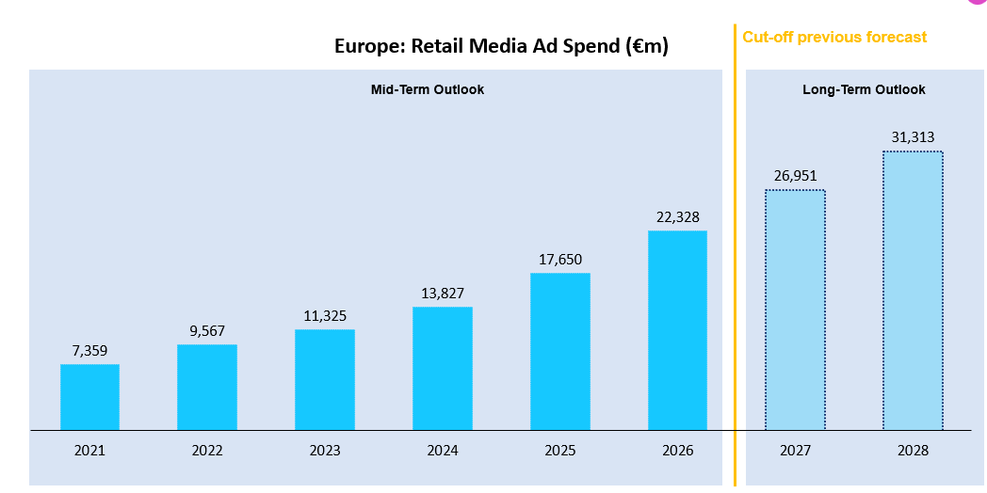
RETAIL MEDIA IN EUROPE FORECAST TO BE WORTH
€31BN IN 2028
Source: IAB Europe

Slide 35
Uk is the largest RETAIL MEDIA market
CAGR 2023-28
+17.6%
+15.6%
+18.7%
+23.5%
+23.6%
+15.0%
+21.3%

Slide 36



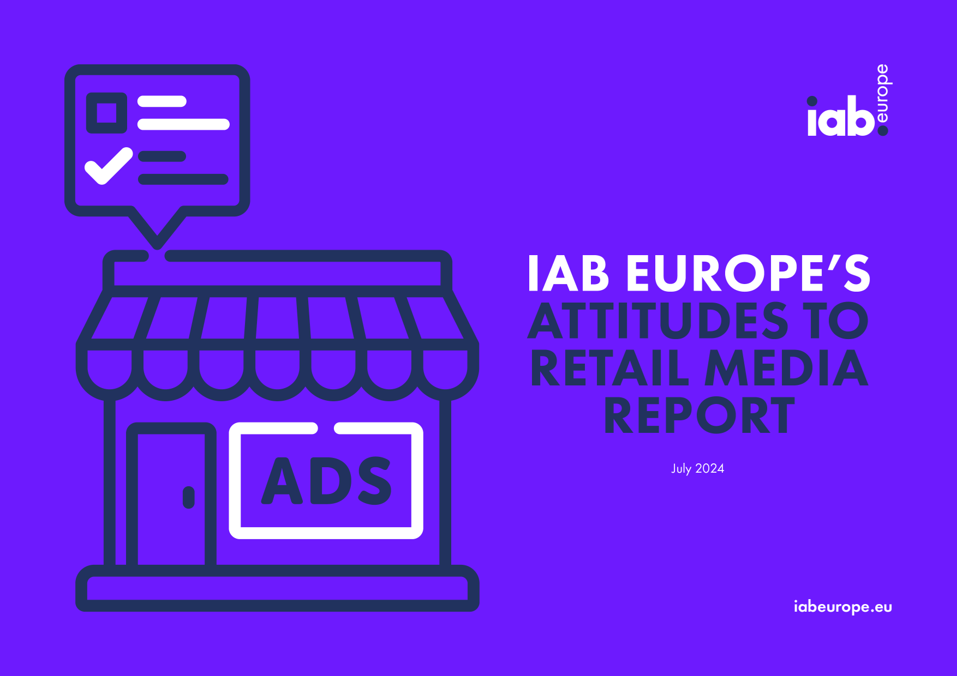

  FRAGMENTATION, LACK OF STANDARDS AND TECH LIMITATIONS hinder investment
58% of buy-side stakeholders cite fragmentation and the lack of standardisation as barriers to retail media investment
53% also cite the fact that retail media networks are not integrated with other technology as a barrier
A further 50% cite the lack of technology available as an investment barrier

Slide 37
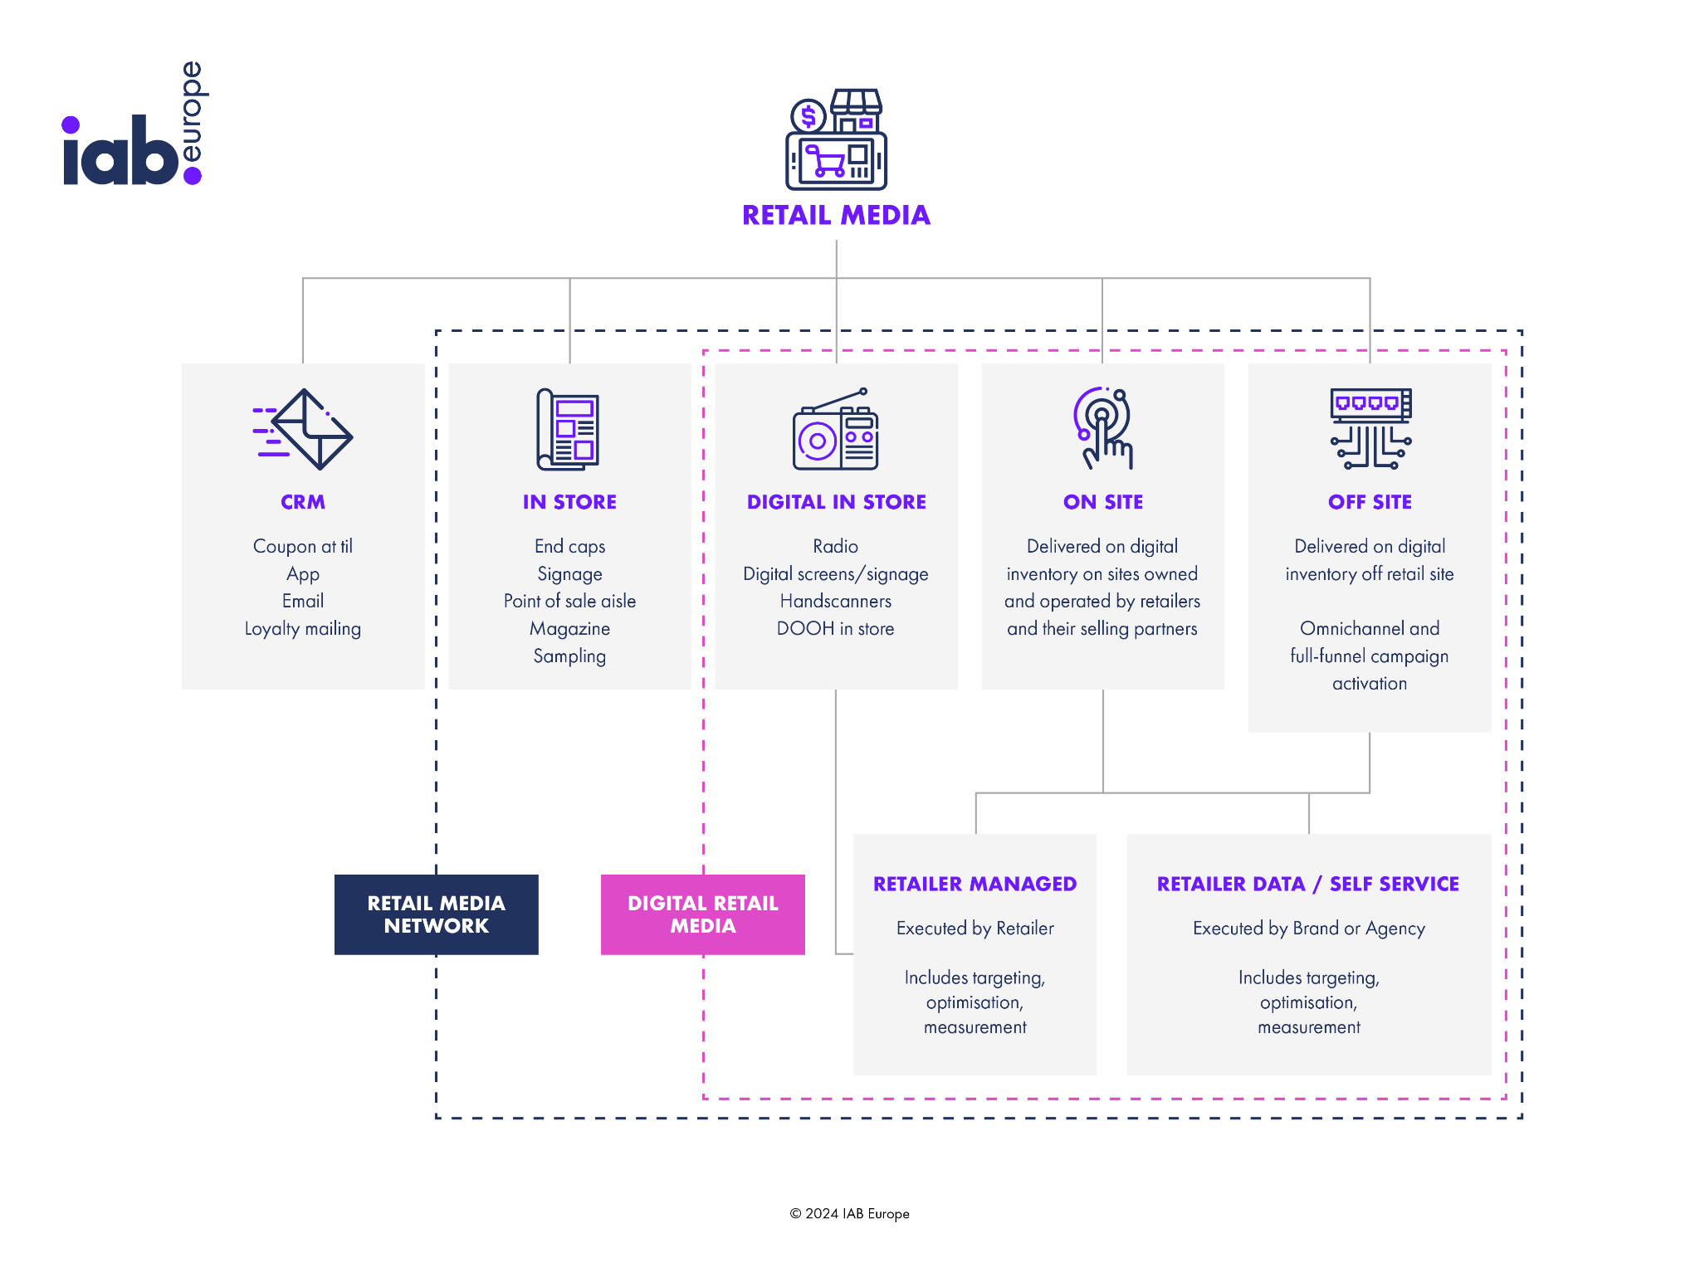

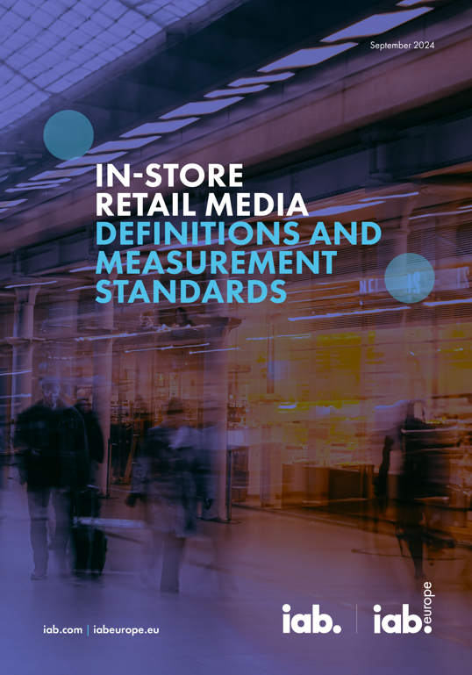
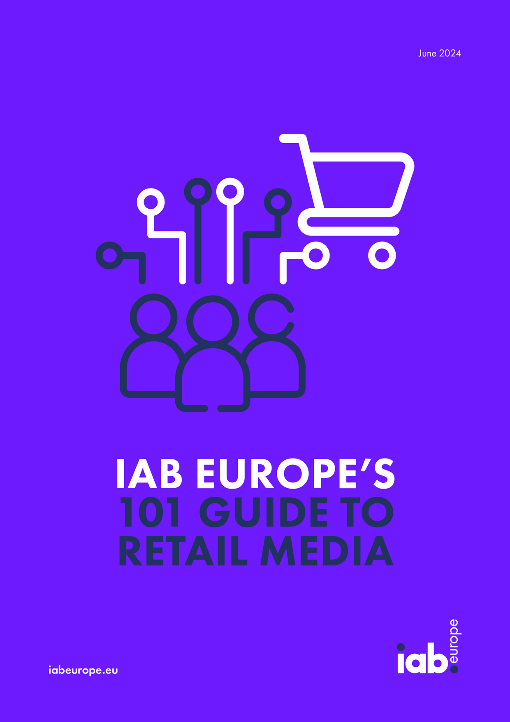
OUR RETAIL MEDIA WORK TO DATE - ADDRESSING THE CHALLENGES AND HELPING TO SCALE THE OPPORTUNITY
1. Aligning on Definitions
2. Defining Pan-European Standards
3. Providing Market Education

Slide 38


OUR STANDARDS COVER THE ENTIRE digital RETAIL MEDIA ECOSYSTEM FROM ON-SITE TO digital IN-STORE

Slide 39
  DEVELOPMENT OF THE STANDARDS: A COLLABORATIVE PROCESS
January
Onsite & Offsite Standards Workshop with 15 Retailers / RMNs
February
Wider Retailer / RMN & buy-side input
March
Industry wide public comment
April
V1 Onsite & Offsite Standards released
October
Certification Launched Beta Phase for Onsite & Offsite Standards
July
In-Store Standards Workshop
September-October
Industry wide public comment
August
Virtual buy-side and sell-side Workshops
November
V1 In-Store Standards released
Onsite & Offsite Retail Media
In-Store Retail Media

Slide 40

  Next step is to certify companies that show compliance with standards
The IAB Europe Retail Media Certification is an industry-recognised programme that rewards adherence to the IAB Europe measurement standards for on and off-site Retail Media campaigns. By earning this certification, retailers can demonstrate their commitment to transparency, fairness, and accountability in Retail Media reporting.

Slide 41
Thank you
Marie-Clare Puffett
Industry Development & Insights Director puffett@iabeurope.eu

