Slide 1
The UK Cross-Media Measurement Platform
Intro to Origin
April 2025

Slide 2
Market challenges
Channel & Format Proliferation
Audience
Fragmentation
Siloed, Proprietary Measurement

Slide 3
Origin is a world-first solution
Advertiser led
Single source
Privacy safe
Independently audited
© Origin 2025

Slide 4
1
Drive
Efficiency
2
Improve Audience Experience
3
Increase Campaign Effectiveness
© Origin 2025

Slide 5
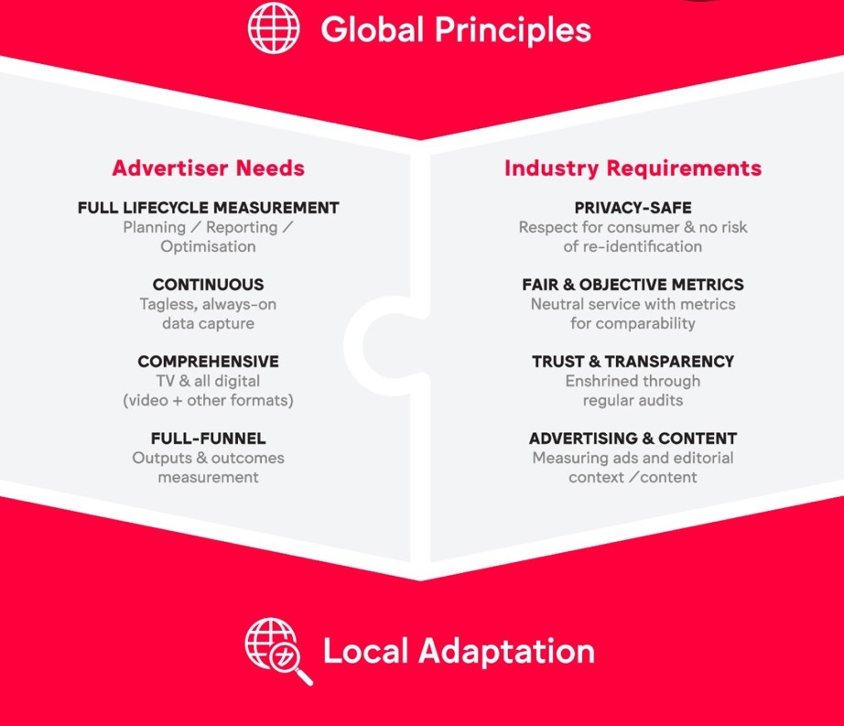
Part of the WFA’s global framework

Slide 6
Over 50 funding stakeholders involved in service design

Slide 7
Near term roadmap – progressive expansion of end user base
Q1 2025
Q2 2025
Q3 2025
Q4 2025
Q1 2026
Q2 2026
Beta Trial
Platform development & stability
User feedback
Pilot
Platform development & stability
Contractual completion
Expanded Availability

Slide 8
Beta Trial - High Level Summary
46
Advertisers & agencies onboarded
£3bn
Annual media spend
>80%
UK media agency billings
750+
Reports generated

Slide 9
New features dropping across 2025…
Q1
Q2
Q3
Q4
Demographic filters
Incremental reach
Measured by Origin (MBO)
API connection
API end–to-end
Premium Reporting
TikTok inventory
Social Grade Demos
Report slicing – device
Extended data availability
Amazon inventory
Reach overlap reports
Report scheduling

Slide 10
…and greater media coverage
Post 2025
2025
TV
70%
UK Adspend
>90%
UK Adspend

Slide 11
Origin Use Cases:
Supporting Campaign Decisions
© Origin 2025

Slide 12
Supporting decisions to drive campaign effectiveness
In-flight Optimisation
Post-campaign Analysis
Strategic Planning
A core contributor to weekly reporting
Which media channels are delivering most effectively against our core KPI?
Frequency
Unique reach/ incremental reach
Quality reach - Viewability and view through rates
Cost per reach/ frequency
Flighting/ ad stock
This would enable you to move budget for short term course correction mid campaign
A core component of a PCA or a QBR
What did we learn last time and what could we do differently next time?
Which partners deliver most reach?
Which partners deliver most unique reach?
Which partners deliver most cost effective reach?
Who is driving frequency of message?
Who is driving completed reach – apples and apples comparisons on view through rates
How does our campaign cover build?
How can Origin contribute to bigger decisions for planning forward
Weights behind my media partners
Strategic role of the partners
Brand visibility in a time period – looking at my performance across multiple campaigns rather than just one campaign:
Total no. campaigns to run at any time
Creative placements
View through rates
Frequency of message
Channel hierarchy in strategic planning
Most relevant target audience
In-campaign course correction
How to improve future campaign execution
Structural effectiveness:
channel role, measurement approach, etc.

Slide 13
Origin enables you to see your de-duplicated Total Campaign Delivery (ie Reach and Frequency) for the first time. From gross siloes to actual net campaign delivery
Illustrative data!
Siloed Gross Audience Reach
(31m + 13.5m + 5.3m ≠49.7m)
40.1m (69%) reach of All Adults at 4.64 OTS
31.0m
5.2m
Vendor 2
Vendor 1
Vendor 1
13.5m
Vendor 2
Vendor 3
Vendor 3
*not to scale
*not to scale
**Synthetic data for illustrative purposes
Notes:
2.47, 0.95, 5.68

Slide 14
Unique & duplicated reach – touchpoint roles
Illustrative data!
Vendor Channel Reach
Adults Millions, Total Reach (+1)
31.0m
8.8m (28%)
Vendor 1 Unique Audience
Vendor 2 Unique Audience
Vendor 3 Unique Audience
Duplicated Audience
13.5m
22.2m (72%)
6.9m (51%)
5.2m
2.8m (55%)
2.3m (45%)
6.6m (49%)
Vendor 1
Vendor 2
Vendor 3
CAN BE FILLED
WITH YOUR DATA
Total spend (£)
___
___
___
Cost per 1,000 (£CPM)
___
___
___
CPM = Cost/ Impressions x 1000
How to optimise in-campaign reach?
How could future campaigns be structured?
What is the role of each medium?
How cost effective is each vendor?
**Synthetic data for illustrative purposes

Slide 15
Overlap reports – where is duplication happening and how much real overlap is there?
Illustrative data!
Siloed Gross Audience Duplication
(8.8m + 2.8m + 6.9mm ≠18.5m)
9m cross over (22% of net campaign reach)
2.3m
Vendor 2 (5.2m)
Vendor 1 (31m)
Vendor 1
22.2m
2.8m
8.8m
6.6m
9m
(22%)
6.9m
Vendor 2
Vendor 3 (13.5m)
Vendor 3
*not to scale
*not to scale
**Synthetic data for illustrative purposes
Notes:
2.47, 0.95, 5.68

Slide 16
Overlap reports – where is duplication happening and how much real overlap is there?
Illustrative data!
Siloed Gross Audience Duplication
(8.8m + 2.8m + 6.9mm ≠18.5m)
9m cross over (22% of net campaign reach)
2.3m
Vendor 2 (5.2m)
Vendor 1 (31m)
Vendor 1
22.2m
2.8m
8.8m
6.6m
18%
6.9m
1%
1%
Vendor 2
2%
Vendor 3 (13.5m)
Vendor 3
*not to scale
*not to scale
**Synthetic data for illustrative purposes
Notes:
2.47, 0.95, 5.68

Slide 17
Incremental reach – helping to manage across touchpoints
Illustrative data!
Incremental Unique Reach
Adults Millions, Total Reach (+1)
6.6
2.3
31.1
22.2
Vendor 1
Vendor 2
Vendor 3
Total
What is the role of each vendor?
Portfolio touchpoint management
Budget shifts
This document has been created with synthetic data for illustrative purposes only

Slide 18
Understanding cover build by video completion status
Illustrative data!
Cumulative Audience Reached with 100% Video Exposure – Total Campaign
Adults Millions, Cumulative Reach (+1)
How to optimise view through rates
45
40
40
40
37
37
39
39
35
30
30
28
33
33
30
31
31
25
21
27
20
24
14
20
81%
viewed the ad to completion
15
16
10
4
12
5
0
3
WK 1
WK 2
WK 3
WK 4
WK 5
WK 6
WK 7
WK 8
WK 9
WK 10
WK 11
All Measurable Impressions
Custom (100% VTR)

Slide 19
Completion status by vendor
Illustrative data!
Cumulative with 100% VTR – Vendor 3
Adults Millions, Cumulative Reach (+1)
Cumulative with 100% VTR – Vendor 1
Adults Millions, Cumulative Reach (+1)
15
14
14
14
14
14
40
12
29
29
31
31
9
30
25
27
10
7
20
22
9
9
9
10
10
20
16
24
26
26
28
28
5
7
12
20
22
5
2
10
4
18
4
5
11
14
0
2
0
0
1
0
3
WK 1
WK 2
WK 3
WK 4
WK 5
WK 6
WK 7
WK 8
WK 9
WK 10
WK 11
WK 1
WK 2
WK 3
WK 4
WK 5
WK 6
WK 7
WK 8
WK 9
WK 10
WK 11
All Measurable Impressions
Custom (100% VTR)
All Measurable Impressions
Custom (100% VTR)
Does each vendor play the role expected
How could future campaigns be improved

Slide 20
Frequency and Impressions
Illustrative data!
How to optimise future campaign frequency
Assigning roles to each vendor
Private and Confidential
This document has been created with synthetic data for illustrative purposes only
Notes:
Three Key Points Comparison Text Icon Work speed settings gear

Slide 21
The voice of the advertiser
Matt Thomas
Senior Director, Brand & Media, N Europe

Slide 22
FAC – Fractional Advertiser Contribution
0.1% on all media
Automated collection via agency
© Origin 2025

Slide 23
Roadmap that supports media-neutral planning
Premium Reporting
Core Reporting
Planning
Outcomes

Slide 24
Thank you
Origin
12 Henrietta Street
London
WC2E 8LH
Martin Lawson
martinl@isba.org.uk
originmediameasurement.com

