Slide 1
The Responsible Media Guide March 2025

Slide 2
Introduction – why have we created this guide?
Advertising drives sales, builds brand equity, and reflects social shifts and behaviors however our members have told us that the pressure of meeting regulatory standards and implementing responsible media best practices is a high priority issue
Create impartial brand led advice for those who want to commit to ethical, sustainable, and impactful advertising
Draws on ISBA’s experts and industry involvement across each fast-evolving topic
Educate for better conversations with partners and internal teams embedding corporate ESG goals into media practices
Introduction
Sustainability
Inclusion
Ai
Digital Governance
Brand Safety

Slide 3
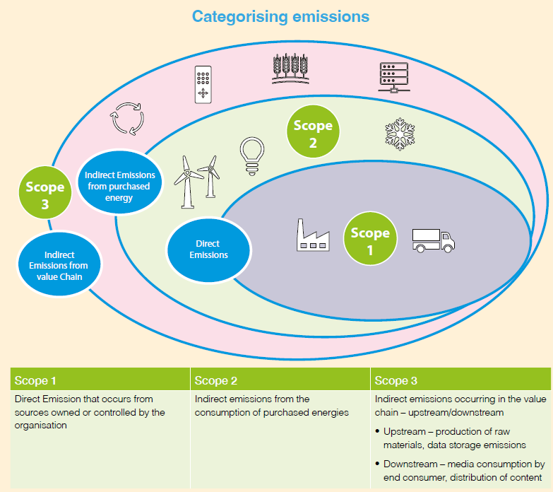
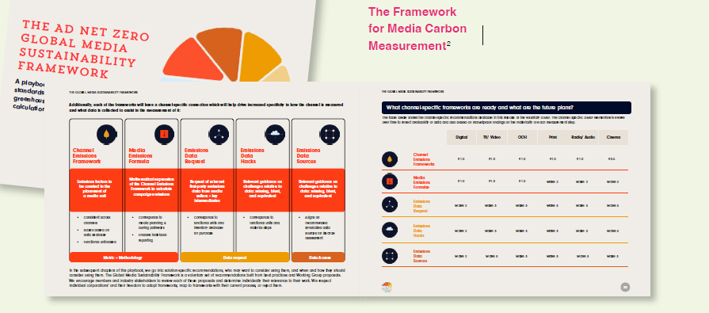
Sustainability
Climate emergency: Advertising's role in promoting sustainable options and aligning with carbon reduction strategies
Global Media Sustainability Framework (GMSF): Standardised methodologies for measuring and reducing media-related emissions
Practical tips: Implementing sustainability practices in media planning and buying
Introduction
Sustainability
Inclusion
Ai
Digital Governance
Brand Safety

Slide 4
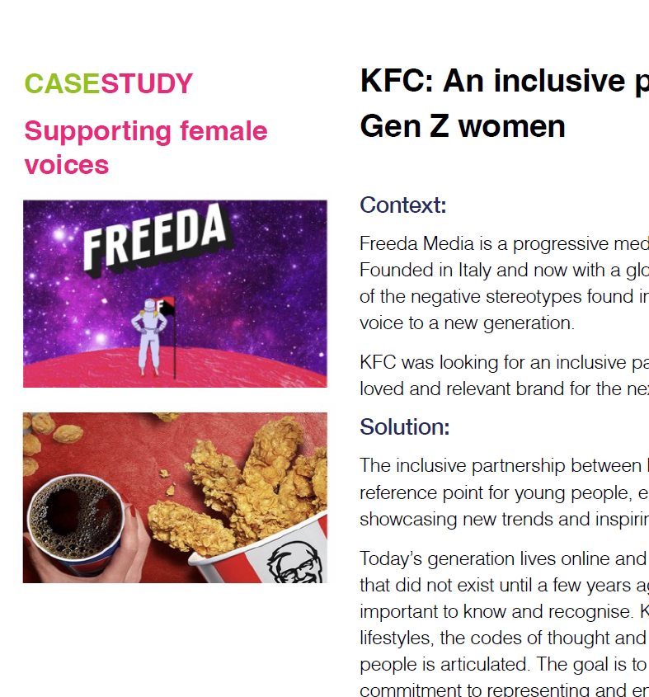
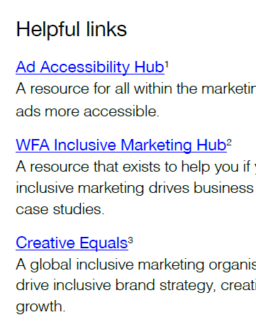
Inclusion
Inclusive Media Strategy Framework: Importance of reaching diverse audiences and supporting minority-owned media vendors
Accessible Advertising: Creating accessible advertising for people with disabilities
Practical tips: Strategies for creating authentic connections with diverse audiences
Introduction
Sustainability
Inclusion
Ai
Digital Governance
Brand Safety

Slide 5
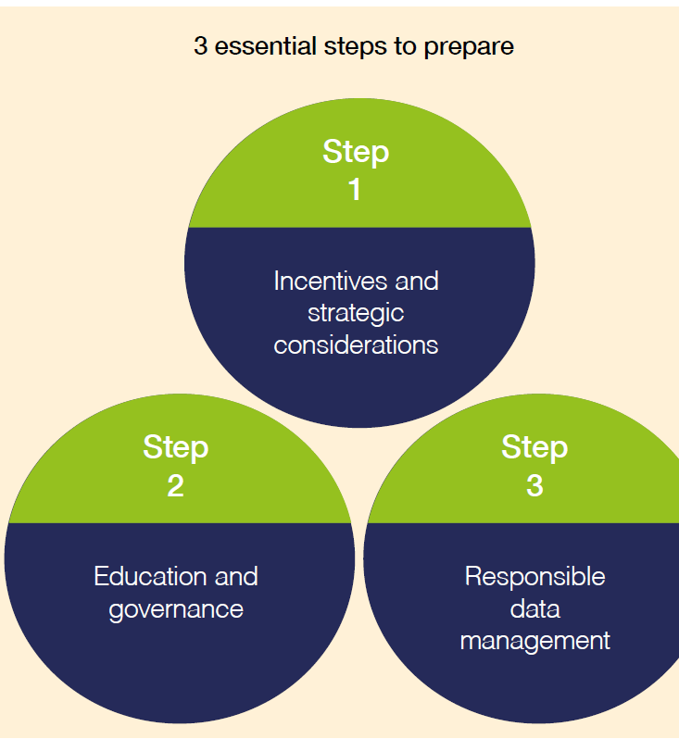
Artificial Intelligence
Responsible adoption of AI: Incentives, strategic considerations, education, governance, and responsible data management
Addressing ESG: Ensuring transparency and reducing negative environmental impacts
Practical tips: Selecting AI vendors and managing legal and regulatory risks
Introduction
Sustainability
Inclusion
AI
Digital Governance
Brand Safety

Slide 6
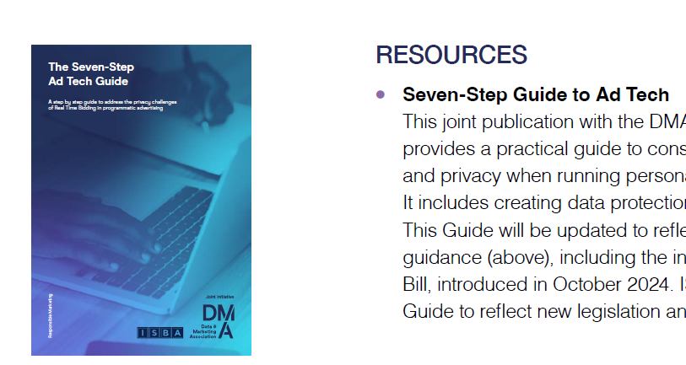
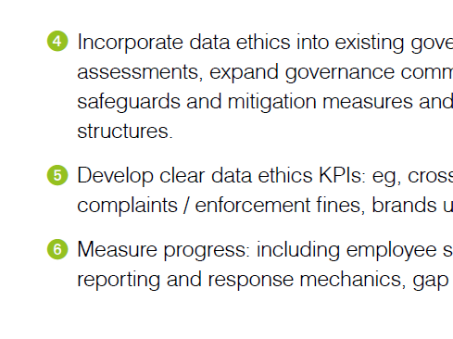
Digital & Data Governance
Regulatory compliance: Ensuring compliance with data protection and privacy legislation
Digital data ethics: Establishing good practices for data management and protecting consumer data
Practical tips: Safeguarding consumer data in the supply chain
Introduction
Sustainability
Inclusion
Ai
Digital Governance
Brand Safety

Slide 7
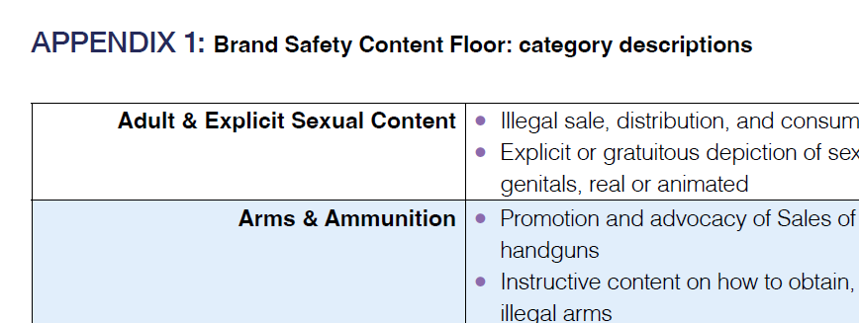
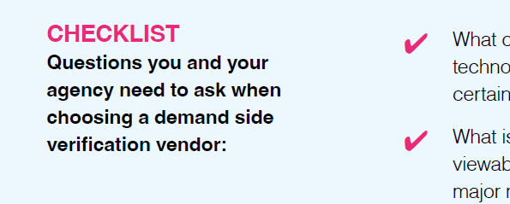
Brand Safety
Brand Safety vs. Brand Suitability: Protecting brand reputation and ensuring ads are placed in appropriate contexts
Managing Online Brand Safety: Guidelines for managing brand safety in digital advertising
Practical tips: Questions to ask your verification partners and ensuring ads appear against appropriate content
Introduction
Sustainability
Inclusion
Ai
Digital Governance
Brand Safety

Slide 8
For more information on Responsible Media contact DanL@isba.org.uk
If you’re interesting finding out more about the benefits of ISBA membership, contact EmmaS@isba.org.uk

