Slide 1
The UK Cross-Media
Measurement Platform
ISBA Council
October 9th, 2025

Slide 2
Agenda
Programme update
Driving adoption – Origin onboarding process
Driving adoption – Origin use cases and questions to ask your agency
Barb meeting 19th November

Slide 3










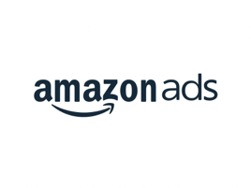


















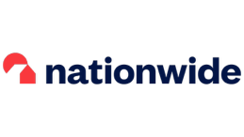

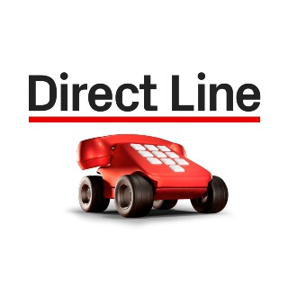













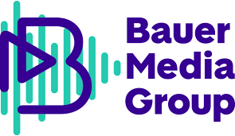
















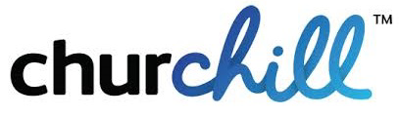










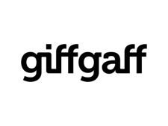



Now 80 stakeholders engaged in the programme

Slide 4
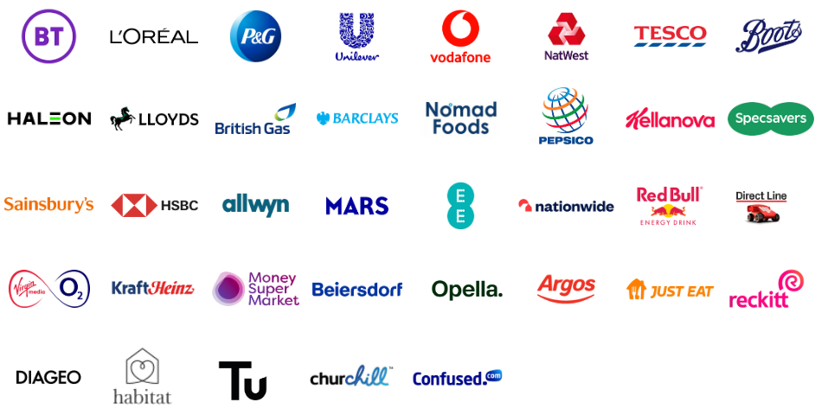
New advertisers onboarding, prospect pipeline continues to grow
1
2
3
Current Users
Fast Followers
Warm Leads
Contracting & onboarding in progress. Many already paying FAC*.
Phased onboarding for future Fast Followers.
ABF
AJ Bell
Aldi
Arla
Autoglass*
AXA
Bayer
Beam Suntory
Bel
Bet365
Burger King
Cancer Research UK
Coca Cola
Colgate-Palmolive
Coty
Curry’s
Danone
DFS
Domino’s
Dreams
Dr Oetker
easyJet
EDF Energy
Entain
Ferrero
Flutter
Friesland Campina
Furniture Village
General Mills
Giffgaff*
Gousto
Haribo
Heineken
Henkel
ITV
JP Morgan Chase
Kenvue
Kerry
KIA
KP Snacks
Lebara
Lenovo
Lidl
Mattel
Molson Coors
Muller
Nando’s
Nestle
Open University
Paddy Power
Paramount
Postcode Lottery
Premier Foods
Puig
Rightmove
Screwfix
Sony Pictures
Three
TJX
TUI
Uber Eats
Vitality
Volvo
Waitrose*
Walt Disney
Warburtons
Wella
Xero
Zurich
Aviva*
British Airways*
Estee Lauder
JLR*
John Lewis*
Kimberly Clark*
Marks & Spencer
Post Office
Renault
Saputo*
Sky*
Standard Life*
SunLife*
Taylors*
40
54
121

Slide 5













70% market coverage by ~end 2025. Increasing further across 2026 & beyond
2026+
2025
TV
70%
UK Adspend
>80%
UK Adspend

Slide 6






2. Driving adoption – Origin onboarding process
3 distinct stages to onboarding
Advertiser
1. Induction
‘Hypercare’
Hands-on support from customer success team
2. FAC payment
3. Contract ‘MCA’
Induction & payment can be expedited quickly
The contract often needs input from legal, so can be the longest pole
We are exploring ways of enabling access whilst the contract is still being worked on

Slide 7
3. Driving adoption – Origin use case
By providing de-duplicated R&F, Origin delivers clear use cases and real impact - enabling marketers to optimise spend for better ROI
01
Can I get more reach within my budget?
I want to maximise overall campaign 1+ reach within my budget using x channels (unique reach and duplicated reach of channels)
04
Can I remove excessive frequency?
I want to reduce wastage from excessive frequency resulting from cross-media exposure
Can I pay less for overall campaign reach?
I want to maintain overall campaign 1+ reach with a lower budget (incremental reach and cost per)
05
Can I get a better distribution of campaign frequency?
I want to optimise campaign spend to target an ideal campaign frequency of x
02
03
I'm committed to Channel A as my campaign anchor. How can I maximise further reach with my remaining spend?
I want to maximise incremental reach with my budget from channels B & C after allocating y% to channel A
06
Can I get more duration of exposure for my budget?
I want to maximise video completion status across campaign touchpoints
7

Slide 8
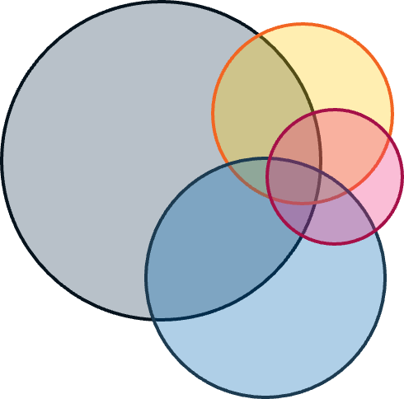



Can I get more reach within my budget?
I want to maximise overall campaign 1+ reach within my budget using x channels
Identify opportunities to maintain reach with lower budgets:
Increase budgets with vendors that deliver cost efficient reach of unique audiences
Negotiate harder/reduce budgets with vendors with inefficient costs per unique reach point
01
02
Can I pay less for overall campaign reach?
I want to maintain overall campaign 1+ reach with a lower budget
“The ability to view data across our campaigns & media channels in a consistent & comparable manner, is a first for us.
This will enable significant improvements in how we increase cross-media reach at a campaign level.
We are excited about the power of this data to fuel the effectiveness of our media investment.”
Matt Thomas
Brand & Media N Europe

Slide 9
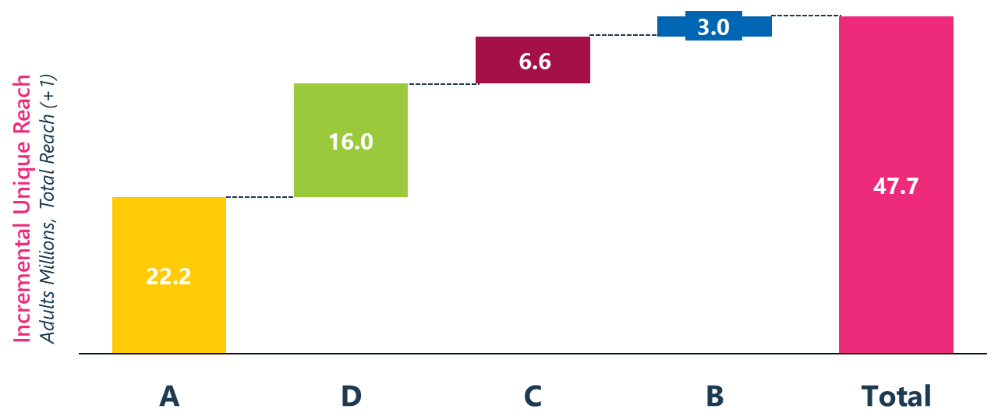

Identify opportunities to maximise incremental reach:
Manage touchpoints on a portfolio basis to maximise incremental reach
03
I'm committed to Channel A as my campaign anchor. How can I maximise further reach with my remaining spend?
I want to maximise incremental reach with my budget from channels B & C after allocating y% to channel A
“Origin will be transformational for advertising and will ultimately help to grow incremental reach for Unilever brands.
Origin’s ability to anchor channels and examine different contributions to incremental coverage will help us to deliver more value from our campaigns.”
Melissa Orchard
Global Integrated Brand Experience
Innovation Director

Slide 10
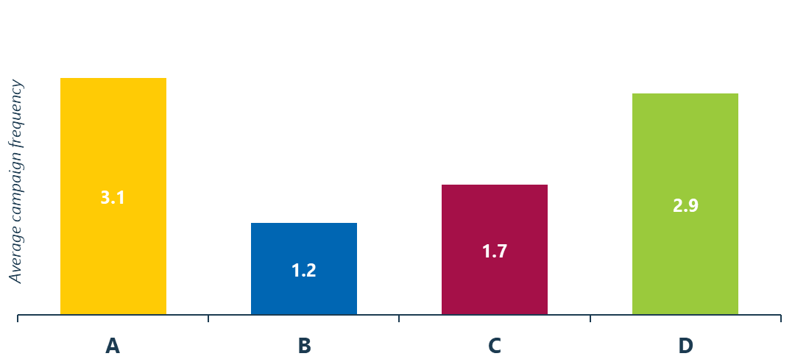
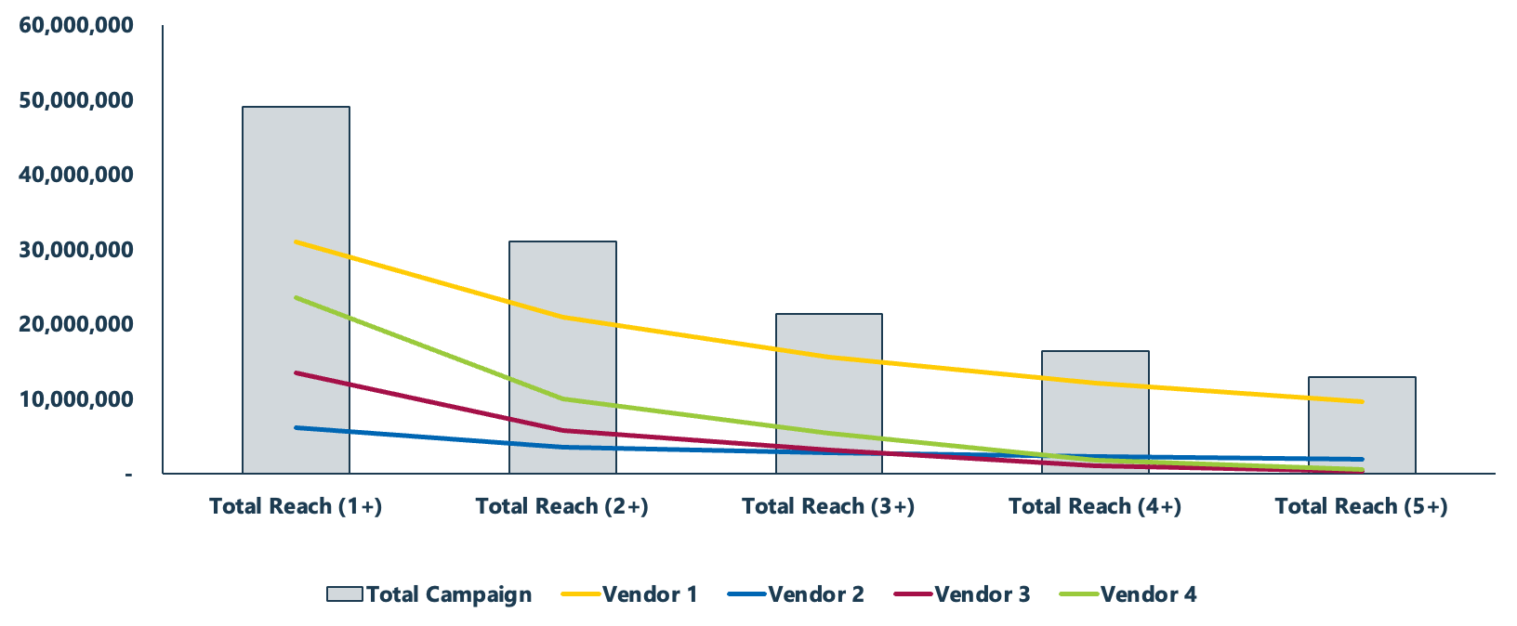

Identify opportunities to optimise aggregate frequency:
Manage frequency across touchpoints on a portfolio basis to eliminate wastage
Optimise the aggregated frequency profile across touchpoints to maximise sweet-spot total exposure levels to improve campaign effectiveness
04
Can I remove excessive frequency?
I want to reduce wasteful excess frequency resulting from cross-media exposure
05
Can I get a better distribution of campaign frequency?
I want to optimise campaign spend to target an ideal campaign frequency of x
“Origin’s ability to surface aggregated frequency across multiple touchpoints is a game-changer for us.
This report output allows us to plan campaigns that deliver an optimal combined frequency across any given permutation of media owners”
Tom Mardon
Head of Media & Campaign Planning,
Tesco

Slide 11
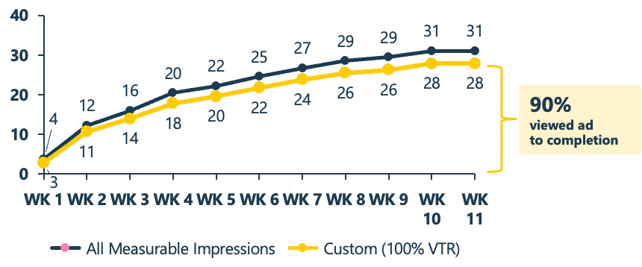
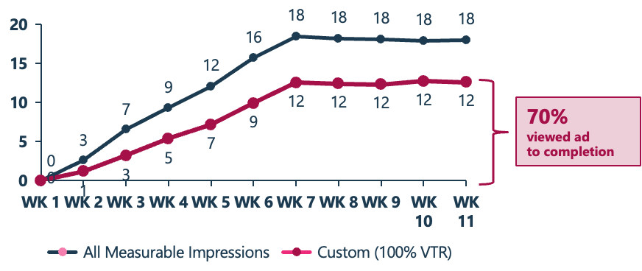

Origin allows TV & digital video touchpoints to be compared on a like-for-like basis for the first time
Are campaign touchpoints delivering exposure duration vs expectation?
How can I use this data alongside other signals to optimise campaign delivery?
06
Can I get more duration of exposure for my budget?
I want to maximise video completion status across campaign touchpoints
“Origin gives us the ability to compare the exposure of each touchpoint for any particular format.
In the context of TV, we are finally able to compare ad exposure with digital video on a like-for-like basis giving second-by-second comparisons.
This has never been possible until now and represents a substantial move forward in campaign insights.”
Ed Sanderson
Head of Media & Planning,
PepsiCo

Slide 12
3. Driving adoption – questions to ask your agency
Are you using Origin?
How does it inform your planning tools?
How is Origin used in campaign reports?
How can I maximise the benefits of Origin?
What is your roadmap for using Origin?
Do you have active dialogue with Origin?

Slide 13



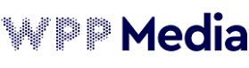
4. Barb meeting, 19th November
Asks:
Brand owner attendance at meeting
ISBA mandate for Origin linear TV data
Communicate this position strongly with your agency teams

Slide 14
Thank you
Origin
  12 Henrietta Street
  London
  WC2E 8LH
Tom George, CEO
  TomG@isba.org.uk
  originmediameasurement.com

